Slide 1


DEPARTMENT OF ELECTRONIC AND COMMUNICATION ENGINEERING
MIMO FSO COMMUNICATION USING HYBRID SUBCARRIER INTENSITY MODULATION OVER
DOUBLE GENERALISED GAMMA FADING
GUIDE
Mr. Piyush Jain
Group Members
Honey Singh (1609731036)
Jaivardhan Sharma(1609731038)
Jayesh Singh(1609731041)
Krishn Gopal Dwivedi(1609731047)

Slide 2
TABLE OF CONTENTS
INTRODUCTION
MOTIVATION
OBJECTIVE
LITERATURE REVIEW
SYSTEM MODEL
MATHEMATICAL MODEL
RESULT AND DISCUSSION
CONCLUSION
PUBLICATION
REFERENCES
FSO |
2

Slide 3
INTRODUCTION
Free-space optics (FSO) is wireless technology to transmit data through light waves.
It is Line of Sight (LOS) communication which uses narrow beam of light.
Some advantages of FSO are huge bandwidth , low power requirement and unlicensed spectrum.
FSO has other benefits like cost effectiveness, easy installation and maintenance.
It can be used in many areas like in military , space agencies ,difficult terrains etc.
FSO |
3

Slide 4
INTRODUCTION(CONTD.)
FSO have some shortcomings like fading , absorption and scattering of signal.
Major concern of FSO system is uncertainty in channel due to Atmospheric Turbulence.
Many statistical models have been proposed to model Atmospheric Turbulence.
These model are used to describe the PDF of irradiance fluctuation.
Some of these models are Negative exponential , Log Normal , and Gamma-Gamma.
Lognormal distribution widely used model but it analysis only weak turbulence.
We have used new statistical model Double Generalized Gamma distribution which is applicable to all turbulence conditions.
FSO |
4

Slide 5
INTRODUCTION (contd.)
The modulation techniques can further be utilized to reduced the impact of turbulence.
There are different modulation techniques like PPM ,BPSK ,MPSK and OOK.
Power efficiency and data rate are important parameters for selection of modulation.
We have used Hybrid modulation which is combination of two or more modulation techniques. For example PPM-MPSK.
Using Hybrid LPPM-MPSK combines the advantages of PPM and MPSK
FSO |
5

Slide 6
MOTIVATION
To achieve higher data rate with cost effectiveness FSO have been used.
FSO systems are also easy to deploy and maintain in difficult terrains.
Double GG distribution is proposed to model Atmospheric Turbulence under all conditions.
LPPM MPSK SIM Hybrid Modulation is used to combines the advantages of LPPM and MPSK SIM.
MIMO systems are used to mitigate the efforts are turbulence induced fading.
FSO |
6

Slide 7
OBJECTIVE
To model MIMO FSO Communication system with hybrid modulation technique over double generalized gamma distribution in the presence of the atmospheric turbulence-induced fading.
To analyze the effect of BER over average electrical SNR under various atmospheric turbulence conditions.
FSO |
7

Slide 8
LITERATURE REVIEW
S.NO. | REFERENCES | FINDINGS | LIMITATIONS
1. | Yi, X., Yao, M. and Wang, X., 2017. MIMO FSO communication using subcarrier intensity modulation over double generalized gamma fading. Optics Communications, 382, pp.64-72.[1] | Average SER for SIM based MIMO FSO system is calculated. | BER performance of BPSK SIM is not analyzed which is better than MPSK SIM.
2. | Kashani , M.A., Uysal , M. and Kavehrad, M., 2015. A novel statistical channel model for turbulence-induced fading in free-space optical systems. Journal of Lightwave Technology, 33(11), pp.2303-2312.[2] | BER as well as outage probability of SIMO and SIMO FSO system. | No modulation technique is employed.
3. | Liu, H., Liao, R., Wei, Z., Hou, Z. and Qiao, Y., 2015. BER analysis of a hybrid modulation scheme based on PPM and MSK subcarrier intensity modulation. IEEE Photonics Journal, 7(4), pp.1-10.[3] | BER performance of PPM-MSK-SIM. | Log normal distribution is used which is applicable for weak turbulence conditions only.
FSO |
8

Slide 9
LITERATURE REVIEW (contd.)
S.NO. | REFERENCES | FINDINGS | LIMITATIONS
4. | Giri, R.K. and Patnaik, B., 2019. Bit error rate performance analysis of hybrid subcarrier intensity modulation-based FSO with spatial diversity in various weather conditions. Journal of Optical Communications, 40(3), pp.307-314.[4] | BER of PPM MSK SIM. | BER performance for MIMO system is not analysed.
5. | AlQuwaiee, H., Ansari, I.S. and Alouini, M.S., 2016. On the maximum and minimum of double generalized gamma variates with applications to the performance of free-space optical communication systems. IEEE Transactions on Vehicular Technology, 65(11), pp.8822-8831.[5] | Average (BER) and the ergodic capacity (EC). | Weak turbulence condition is not analyzed.
6. | Kashani, M.A., Uysal, M. and Kavehrad, M., 2015, June. On the performance of MIMO FSO communications over double generalized gamma fading channels. In 2015 IEEE International Conference on Communications (ICC) (pp. 5144-5149). IEEE.[6] | BER performance of SIMO ,MISO and MIMO. | Weak turbulence condition is not analyzed.
FSO |
9

Slide 10
LITERATURE REVIEW (contd.)
S.NO. | REFERENCES | FINDINGS | LIMITATIONS
7. | Aminikashani, M., Kavehrad, M. and Gu, W., 2016, February. Error performance analysis of FSO links with equal gain diversity receivers over double generalized gamma fading channels. In Broadband Access Communication Technologies X (Vol. 9772, p. 97720R). International Society for Optics and Photonics.[7] | BER performance of FSO with EGC is analyzed. | MIMO system is not considered.
8. | Jagadeesh, V.K., Palliyembil, V., Muthuchidambaranathan, P. and Bui, F.M., 2015. Free space optical communication using subcarrier intensity modulation through generalized turbulence channel with pointing error. Microwave and Optical Technology Letters, 57(8), pp.1958-1961.[8] | The effects of channel turbulence and pointing error are analyzed for BPSK-SIM FSO system. | BPSK-SIM is used but MPSK which is a better modulation scheme, is not analyzed. MIMO system is also not considered in this paper.
FSO |
10

Slide 11
LITERATURE REVIEW (contd.)
S.NO. | REFERENCES | FINDINGS | LIMITATIONS
9. | Bhatnagar, M.R. and Ghassemlooy, Z., 2016. Performance analysis of gamma–gamma fading FSO MIMO links with pointing errors. Journal of Lightwave technology, 34(9), pp.2158-2169.[9] | Average SER is derived for both EGC and MRC. | Gamma-Gamma distribution is used which does not work for strong turbulence conditions.
10. | Li, J., Liu, J.Q. and Taylor, D.P., 2007. Optical communication using subcarrier PSK intensity modulation through atmospheric turbulence channels.[10] | The BER is derived for optical communication systems. | Log normal distribution is considered therefore strong turbulence condition is not analyzed.
11. | Kaur, P., Jain, V.K. and Kar, S., 2015. Performance analysis of free space optical links using multi-input multi-output and aperture averaging in presence of turbulence and various weather conditions. IET Communications, 9(8), pp.1104-1109.[11] | Performance of FSO link under various weather conditions is evaluated in terms of BER, outage probability and diversity gain. | Gamma-Gamma distribution is used which does not work for strong turbulence conditions.
FSO |
11

Slide 12
LITERATURE REVIEW (contd.)
S.NO. | REFERENCES | FINDINGS | LIMITATIONS
12. | Saeed, R.A. and Abbas, E.B., 2018, August. Performance Evaluation of MIMO FSO Communication with Gamma-Gamma Turbulence Channel using Diversity Techniques. In 2018 International Conference on Computer, Control, Electrical, and Electronics Engineering (ICCCEEE) (pp. 1-5). IEEE.[12] | Examined the diversity combining techniques to minimize fading | Double generalized gamma distribution is not employed.
13. | Johnsi, A.A. and Saminadan, V., 2013, April. Performance of diversity combining techniques for fso-mimo system. In 2013 International Conference on Communication and Signal Processing (pp. 479-483). IEEE.[13] | Analyzed BER and outage probability for different combining techniques which increases system performance. | Log normal distribution is used which is applicable for weak turbulence conditions only.
FSO |
12

Slide 13
LITERATURE REVIEW (contd.)
S.NO. | REFERENCES | FINDINGS | LIMITATIONS
14. | Saber, M.J. and Keshavarz, A., 2018, May. On performance of adaptive subcarrier intensity modulation over generalized FSO links. In Electrical Engineering (ICEE), Iranian Conference on (pp. 358-361). IEEE.[14] | Performance evaluation of adaptive subcarrier PSK intensity modulation over Malaga turbulence channel | PSK is used which has lower bandwidth efficiency.
15. | Sadiku, M.N., Musa, S.M. and Nelatury, S.R., 2016. Free space optical communications: An overview. European scientific journal, 12(9).[15] | Advantages and limitation of Free Space Optical communication. | -
16. | Vellakudiyan, J., Muthuchidambaranathan, P., Bui, F.M. and Palliyembil, V., 2015. Performance of a subcarrier intensity modulated differential phase-shift keying over generalized turbulence channel. AEU-International Journal of Electronics and Communications, 69(11), pp.1569-1573.[16] | Performance analysis of DPSK SIM based FSO system. Expression for BER, channel capacity and outage probability of the system. | DPSK is used which is highly sensitive to phase noise effects.
FSO |
13

Slide 14
LITERATURE REVIEW (contd.)
S.NO. | REFERENCES | FINDINGS | LIMITATIONS
17. | Dabiri, M.T., Sadough, S.M.S. and Khalighi, M.A., 2017. FSO channel estimation for OOK modulation with APD receiver over atmospheric turbulence and pointing errors. Optics Communications, 402, pp.577-584.[17] | BER performance of EM channel estimator is analysed. | OOK modulation is used ,which offers lower power efficiency and is very susceptible to noise interference.
18. | Kaur, G., Singh, H. and Sappal, A.S., 2017. Free space optical using different modulation techniques—a review. International Journal of Engineering Trends and Technology (IJETT), 43(2).[18] | Methods for performance enhancement of FSO link are described . | DPIM and DPPM can also be employed.
19. | Popoola, W.O. and Ghassemlooy, Z., 2009. BPSK subcarrier intensity modulated free-space optical communications in atmospheric turbulence. Journal of Lightwave technology, 27(8), pp.967-973.[19] | The BER expression for SIM FSO is derived. | Spatial diversity is used which is only used for strong turbulence.
FSO |
14

Slide 15
LITERATURE REVIEW (contd.)
S.NO. | REFERENCES | FINDINGS | LIMITATIONS
20. | Prabu, K. and Kumar, D.S., 2015. BER analysis for BPSK based SIM–FSO communication system over strong atmospheric turbulence with spatial diversity and pointing errors. Wireless Personal Communications, 81(3), pp.1143-1157.[26] | BER of BPSK-SIM based SISO and SIMO FSO systems over a strong atmospheric channel with pointing errors are derived. | MIMO system is not employed. Spatial diversity is used which is only used for strong turbulence.
21. | Ting Jiang, Lin Zhao ,Hong Zhang Liu Performance improvement for Mixed RF-FSO Communication System by Adopting Hybrid Subcarrier Intensity Modulation. MDPI Appl. Sci 2019 , 9,3724[27] | The BER expression of hybrid RF-FSO system | Spatial diversity is not considered.
22. | Faridzadeh, M., Gholami, A., Ghassemlooy, Z. and Gatri, A., 2014, September. BPSK-SIM-PPM modulation for free space optical communications. In 7'th International Symposium on Telecommunications (IST'2014) (pp. 794-798). | BER execution of the PPM-BPSK balance plot in the lognormal atmospheric channel. | BPSK-SIM is used but MPSK which is a better modulation scheme, is not analysed. MIMO system is also not considered in this paper
FSO |
15

Slide 16
LITERATURE REVIEW (contd.)
S.NO. | REFERENCES | FINDINGS | LIMITATIONS
23. | Faridzadeh, M., Gholami, A., Ghassemlooy, Z. and Rajbhandari, S., 2012, July. Hybrid 2-PPM-BPSK-SIM with the spatial diversity for free space optical communications. In 2012 8th International Symposium on Communication Systems, Networks & Digital Signal Processing (CSNDSP) (pp. 1-5). IEEE.[29] | BER analysed for various combining techniques and found that system efficiency was increasing. | MIMO system is not MPSK-SIM is not analysed. Spatial Density is considered only for strong turbulence.
24. | Faridzadeh, M., Gholami, A., Ghassemlooy, Z. and Rajbhandari, S., 2012. Hybrid pulse position modulation and binary phase shift keying subcarrier intensity modulation for free space optics in a weak and saturated turbulence channel. JOSA A, 29(8), pp.1680-1685.[30] | The BER expression of hybrid RF-FSO system | Spatial diversity is not considered.
FSO |
16

Slide 17
LITERATURE REVIEW (contd.)
S.NO. | REFERENCES | FINDINGS | LIMITATIONS
25. | Tiwari, Pawan, Nikhil Kumar, Pragati Singh, Chhavi Srivastava, M. Lakshmanan, Piyush Jain, and Saurabh Katiyar. "Modeling and Analysis of Hybrid SIM with L-PPM and MSK over Double Generalized Gamma Distribution in Free Space Optical Communication System." In 2019 International Conference on Vision Towards Emerging Trends in Communication and Networking (ViTECoN), 1-4. IEEE, 2019.[31] | BER performance of SISO FSO system for hybrid LPPM-MSK-SIM over double GG distribution under weak, moderate and strong turbulence conditions is analyzed. | MIMO FSO system is not considered.
FSO |
17

Slide 18
SYSTEM MODEL
FSO
Transmitter
(Hybrid LPPM MPSK-SIM Modulator)
FSO
Communication Channel
(Double GG Fading
Distribution)
FSO
Receiver
(Hybrid LPPM-MPSK-SIM Demodulator)
Input
Output
Fig 1.1. Block Diagram of Hybrid LPPM-MPSK-SIM communication system
FSO |
18

Slide 19
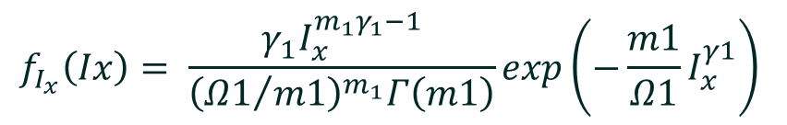
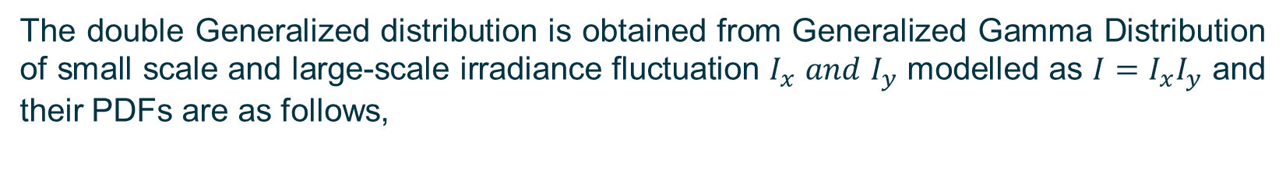
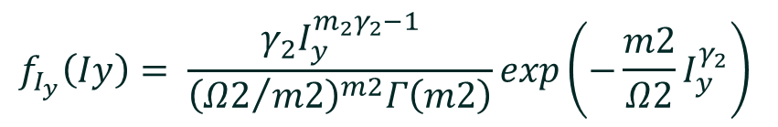
MATHEMATICAL MODEL
PDF OF DOUBLE GENERALIZED GAMMA DISTRIBUTION
The double Generalized distribution is obtained from Generalized Gamma Distribution of small scale and large-scale irradiance fluctuation $I_{x}$ 𝑎𝑛𝑑 $I_{y}$ modelled as $I=I_{x}I_{y}$ and their PDFs are as follows,
$$f_{I_{x}}\left(Ix\right)= \frac{γ_{1}I_{x}^{m_{1}γ_{1}−1}}{{\left({Ω1}/{m1}\right)}^{m_{1}}Γ\left(m1\right)}exp\left(−\frac{m1}{Ω1}I_{x}^{γ1}\right)$$
(1.1)
$$f_{I_{y}}\left(Iy\right)= \frac{γ_{2}I_{y}^{m_{2}γ_{2}−1}}{{\left({Ω2}/{m2}\right)}^{m2}Γ\left(m2\right)}exp\left(−\frac{m2}{Ω2}I_{y}^{γ_{2}}\right)$$
(1.2)
where $γ_{i}$> 0, $m_{i}$> 0.5 and $Ω_{i}$, i = 1, 2 are the parameters of the generalized gamma distribution, $I$ is the irradiance of the received optical wave.
FSO |
19

Slide 20
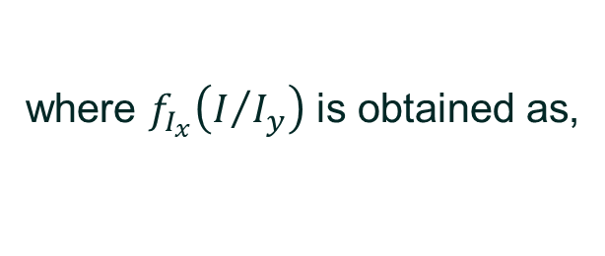

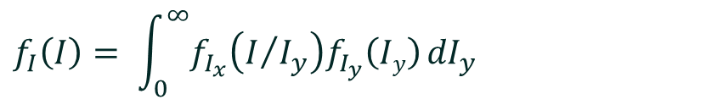

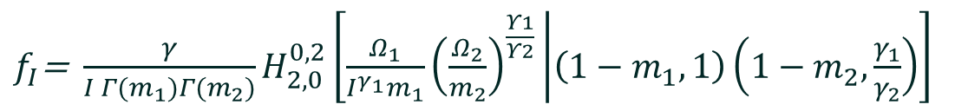
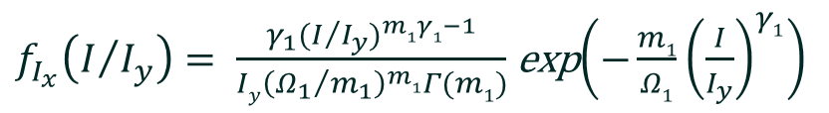
MATHEMATICAL MODEL (contd.)
Thus, the PDF of $I$ can be derived by
$$f_{I}\left(I\right)= \int_{0}^{∞}{f_{I_{x}}\left(I/{I_{y}}\right)f_{I_{y}}\left(Iy\right)}{dI}_{y}$$
(1.3)
where $f_{I_{x}}\left(I/{I_{y}}\right)$ is obtained as,
$f_{I_{x}}\left(I/{I_{y}}\right)= \frac{{γ_{1}(I/{I_{y}})}^{m1γ1−1}}{{Iy\left({Ω_{1}}/{m_{1}}\right)}^{m1}Γ(m1)}$exp$\left(−\frac{m1}{Ω1}{\left(\frac{I}{I_{y}}\right)}^{γ1}\right)$
(1.4)
with the help of [21, Eq (5.5)], the integration in (1.3) yields
$f_{I}$= $\frac{γ}{I Γ(m_{1})Γ(m_{2})}H_{2,0}^{0,2}\left[\frac{Ω_{1}}{I^{γ_{1}}m_{1}}{\left(\frac{Ω_{2}}{m_{2}}\right)}^{\frac{Υ1}{Υ2}} | \left(1−m_{1},1\right)\left(1−m_{2},\frac{γ_{1}}{γ_{2}}\right)\right]$
(1.5)
where $H_{2,0}^{0,2}( )$ is the Fox’s H-function.
FSO |
20

Slide 21
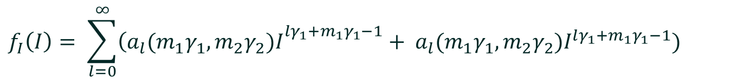
MATHEMATICAL MODEL (contd.)
To avoid dealing with the Fox's H-function, we have expanded it into an infinite power series by using [22, Th.1.4], and therefore obtain the series representation form of the double GG PDF:
$$f_{I}\left(I\right)= \sum_{l=0}^{∞}{{\left(a_{l}(m_{1}γ_{1},m_{2}γ_{2})I\right.}^{lγ_{1}+m_{1}γ_{1}−1}}+ {a_{l}(m_{1}γ_{1},m_{2}γ_{2})I}^{lγ_{1}+m_{1}γ_{1}−1})$$
(1.6)
Where,
$a_{l}(m_{1}γ_{1},m_{2}γ_{2})$= $\frac{γ_{1}}{Γ(m1)Γ(m2)} \frac{{\left(−1\right)}^{l}}{l!} Γ\left(m_{2}−\left(m_{1}+l\right)\frac{γ_{1}}{γ_{2}}\right){(\frac{m_{1}}{Ω_{1}}{(\frac{m_{2}}{Ω_{2}})}^{\frac{γ_{1}}{γ_{2}}})}^{(l+m_{1})}$
(1.7)
$a_{l}(m_{2}γ_{2},m_{1}γ_{1})$= $\frac{γ_{2}}{ Γ(m1)Γ(m2)}$ $\frac{{\left(−1\right)}^{l}}{l!}Γ\left(m_{1}−\left(m_{2}+l\right)\frac{γ_{2}}{γ_{1}}\right){(\frac{m_{2}}{Ω_{2}}{(\frac{m_{1}}{Ω_{1}})}^{\frac{γ_{2}}{γ_{1}}}))}^{(l+m_{2})}$
(1.8)
FSO |
21

Slide 22
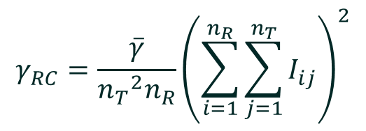
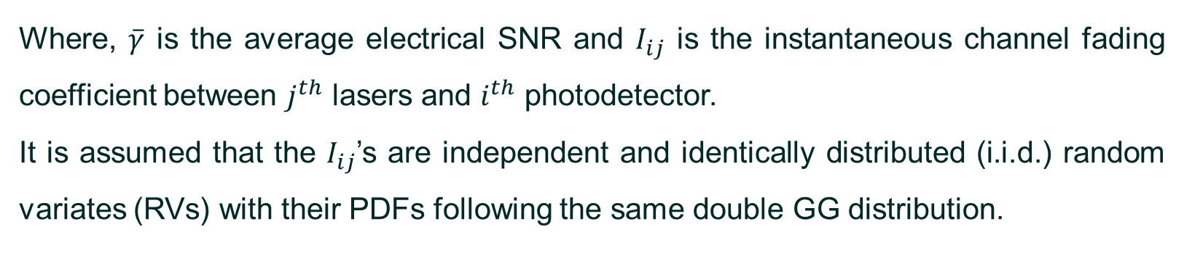
MATHEMATICAL MODEL (contd.)
POST DETECTION ELECTRICAL SNR FOR RC MIMO
For RC MIMO FSO system involving $n_{T}$ lasers and $n_{R}$ photodetectors, the expression for post detection SNR is:
$$γ_{RC}=\frac{\overline{γ}}{{n_{T}}^{2}n_{R}}{\left(\sum_{i=1}^{n_{R}}{\sum_{j=1}^{n_{T}}{I_{ij}}}\right)}^{2}$$
...(1.9)
Where, $\overline{γ}$ is the average electrical SNR and $I_{ij}$ is the instantaneous channel fading coefficient between $j^{th}$ lasers and $i^{th}$ photodetector.
It is assumed that the $I_{ij}$’s are independent and identically distributed (i.i.d.) random variates (RVs) with their PDFs following the same double GG distribution.
FSO |
22

Slide 23
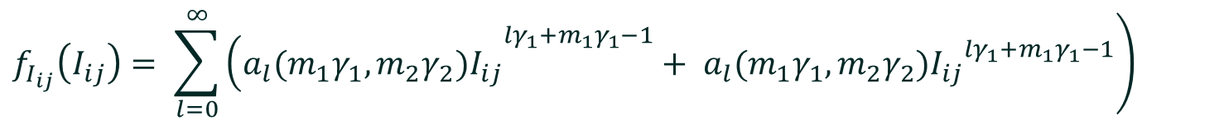
MATHEMATICAL MODEL (contd.)
AVERAGE SYMBOL ERROR RATE OF SUBCARRIER MPSK FOR MIMO FSO SYSTEM WITH RC SCHEME
From equation (1.6) and the assumption that $I_{ij}$ have PDF following the same double GG distribution.
$$\left.f_{I_{ij}}\left(I_{ij}\right)= \sum_{l=0}^{∞}{{\left(a_{l}(m_{1}γ_{1},m_{2}γ_{2})I_{ij}\right.}^{lγ_{1}+m_{1}γ_{1}−1}}+ {a_{l}(m_{1}γ_{1},m_{2}γ_{2})I_{ij}}^{lγ_{1}+m_{1}γ_{1}−1}\right)$$
...(1.10)
Where,
$a_{l}(m_{1}γ_{1},m_{2}γ_{2})$= $\frac{γ_{1}}{Γ(m1)Γ(m2)} \frac{{\left(−1\right)}^{l}}{l!} Γ\left(m_{2}−\left(m_{1}+l\right)\frac{γ_{1}}{γ_{2}}\right){(\frac{m_{1}}{Ω_{1}}{(\frac{m_{2}}{Ω_{2}})}^{\frac{γ_{1}}{γ_{2}}})}^{(l+m_{1})}$
...(1.11)
$a_{l}(m_{2}γ_{2},m_{1}γ_{1})$= $\frac{γ_{2}}{ Γ(m1)Γ(m2)}$ $\frac{{\left(−1\right)}^{l}}{l!}Γ\left(m_{1}−\left(m_{2}+l\right)\frac{γ_{2}}{γ_{1}}\right){(\frac{m_{2}}{Ω_{2}}{(\frac{m_{1}}{Ω_{1}})}^{\frac{γ_{2}}{γ_{1}}}))}^{(l+m_{2})}$
...(1.12)
FSO |
23

Slide 24
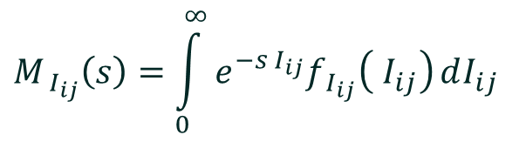
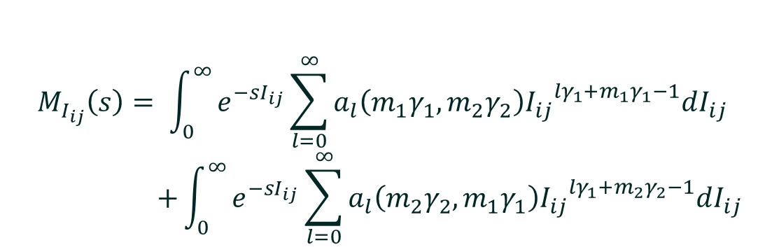
MATHEMATICAL MODEL (contd.)
The Moment Generating Function (MGF) of $I_{ij}$ can be derived in terms of power series:
$$M_{ I_{ij}}\left(s\right)=\int_{0}^{∞}{e^{−s I_{ij}}f_{ I_{ij}}\left( I_{ij}\right)}dI_{ij}$$
...(1.13)
Using equation (1.10) and (1.13)
$$M_{I_{ij}}\left(s\right)= \int_{0}^{∞}{e^{−sI_{ij}}\sum_{l=0}^{∞}{\left[\begin{aligned}a_{l}\left(m_{1}γ_{1},m_{2}γ_{2}\right){I_{ij}}^{{lγ}_{1}+m_{1}γ_{1}−1} \\ + a_{l}\left(m_{2}γ_{2},m_{1}γ_{1}\right){I_{ij}}^{{lγ}_{1}+m_{2}γ_{2}−1}\end{aligned}\right]dI_{ij}}}$$
...(1.14)
$$M_{I_{ij}}\left(s\right)= \int_{0}^{∞}{e^{−sI_{ij}}\sum_{l=0}^{∞}{a_{l}\left(m_{1}γ_{1},m_{2}γ_{2}\right){I_{ij}}^{{lγ}_{1}+m_{1}γ_{1}−1}dI_{ij}}}$$
$$+\int_{0}^{∞}{e^{−sI_{ij}}\sum_{l=0}^{∞}{a_{l}\left(m_{2}γ_{2},m_{1}γ_{1}\right){I_{ij}}^{{lγ}_{1}+m_{2}γ_{2}−1}dI_{ij}}}$$
...(1.15)
FSO |
24

Slide 25
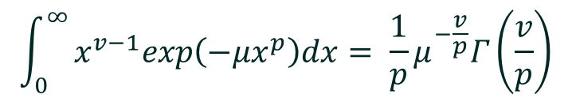
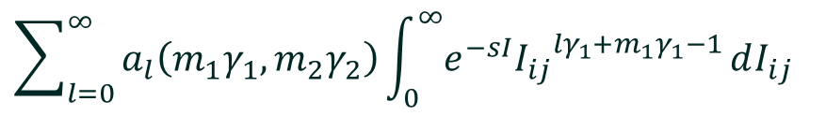

MATHEMATICAL MODEL (contd.)
Considering the first integral of equation (1.15),
$$\sum_{l=0}^{∞}{a_{l}\left(m_{1}γ_{1},m_{2}γ_{2}\right)\int_{0}^{∞}{e^{−sI}{I_{ij}}^{{lγ}_{1}+m_{1}γ_{1}−1}}dI_{ij}}$$
...(1.16)
From equation 3.478(1), Ref 24 we get,
$$\int_{0}^{∞}{x^{v−1}exp\left({−μx}^{p}\right)dx= \frac{1}{p}μ^{−\frac{v}{p}}Γ\left(\frac{v}{p}\right)}$$
...(1.17)
Comparing equations (1.16) and (1.17), we get
$$μ=s, x=I_{ij}, p=1, v={lγ}_{1}+m_{1}γ_{1}$$
...(1.18)
Now, equations (1.16) becomes:
FSO |
25

Slide 26
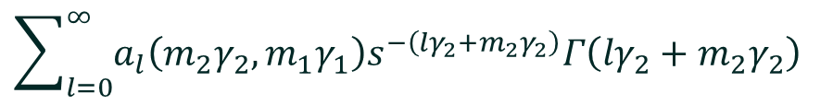
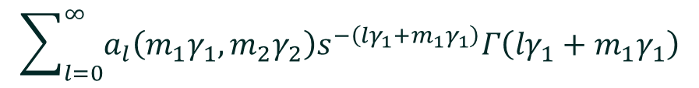
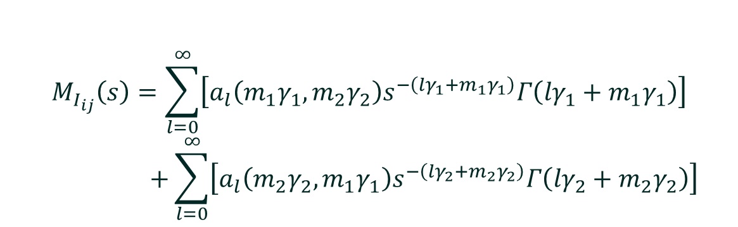
MATHEMATICAL MODEL (contd.)
$$\sum_{l=0}^{∞}{a_{l}\left(m_{1}γ_{1},m_{2}γ_{2}\right)s^{−\left({lγ}_{1}+m_{1}γ_{1}\right)}Γ\left({lγ}_{1}+m_{1}γ_{1}\right)}$$
...(1.19)
Similarly, the second integral of equation (1.15) becomes:
$$\sum_{l=0}^{∞}{a_{l}\left(m_{2}γ_{2},m_{1}γ_{1}\right)s^{−\left({lγ}_{2}+m_{2}γ_{2}\right)}Γ\left({lγ}_{2}+m_{2}γ_{2}\right)}$$
...(1.20)
Now equation (1.15) can be rewritten as:
$$M_{I_{ij}}\left(s\right)=\sum_{l=0}^{∞}{\left[a_{l}\left(m_{1}γ_{1},m_{2}γ_{2}\right)s^{−\left({lγ}_{1}+m_{1}γ_{1}\right)}Γ\left({lγ}_{1}+m_{1}γ_{1}\right)\right]}$$
$$+\sum_{l=0}^{∞}{\left[a_{l}\left(m_{2}γ_{2},m_{1}γ_{1}\right)s^{−\left({lγ}_{2}+m_{2}γ_{2}\right)}Γ\left({lγ}_{2}+m_{2}γ_{2}\right)\right]}$$
...(1.21)
FSO |
26

Slide 27

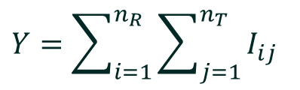
MATHEMATICAL MODEL (contd.)
$$M_{I_{ij}}\left(s\right)=\sum_{l=0}^{∞}{{\tilde{b}}_{l}\left(m_{1}γ_{1},m_{2}γ_{2}\right)s^{−m_{1}γ_{1}−{lγ}_{1}}}+\sum_{l=0}^{∞}{{\tilde{b}}_{l}\left(m_{2}γ_{2},m_{1}γ_{1}\right)s^{−m_{2}γ_{2}−{lγ}_{2}}}$$
...(1.22)
Where
$${\tilde{b}}_{l}\left(m_{1}γ_{1},m_{2}γ_{2}\right)=a_{l}\left(m_{1}γ_{1},m_{2}γ_{2}\right)Γ\left({lγ}_{1}+m_{1}γ_{1}\right)$$
...(1.23)
$${\tilde{b}}_{l}\left(m_{2}γ_{2},m_{1}γ_{1}\right)=a_{l}\left(m_{2}γ_{2},m_{1}γ_{1}\right)Γ\left({lγ}_{2}+m_{2}γ_{2}\right)$$
...(1.24)
Now, let
$$Y=\sum_{i=1}^{n_{R}}{\sum_{j=1}^{n_{T}}{I_{ij}}}$$
...(1.25)
Since $I_{ij}$’s are assumed to be i.i.d. RVs, MFG of Y can be expressed as:
$$M_{Y}\left(s\right)={\left(M_{ij}\left(s\right)\right)}^{n_{T}n_{R}}$$
...(1.26)
FSO |
27

Slide 28
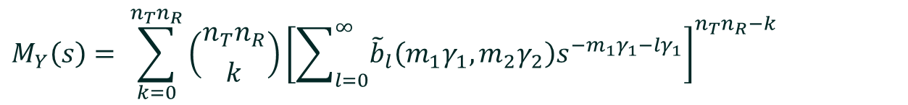
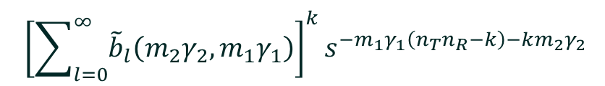
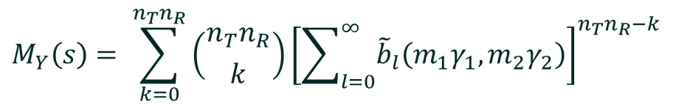
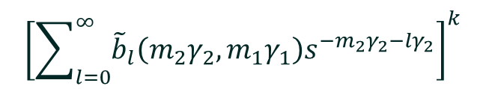
MATHEMATICAL MODEL (contd.)
From equations (1.22) and (1.26),
$$M_{Y}\left(s\right)= {\left[\sum_{l=0}^{∞}{{\tilde{b}}_{l}\left(m_{1}γ_{1},m_{2}γ_{2}\right)s^{−m_{1}γ_{1}−{lγ}_{1}}}+\sum_{l=0}^{∞}{{\tilde{b}}_{l}\left(m_{2}γ_{2},m_{1}γ_{1}\right)s^{−m_{2}γ_{2}−{lγ}_{2}}}\right]}^{n_{T}n_{R}}$$
...(1.27)
By using Binomial Theorem, we get
$$M_{Y}\left(s\right)= \sum_{k=0}^{n_{T}n_{R}}{\left({n_{T}n_{R} \atop k}\right){\left[\sum_{l=0}^{∞}{{\tilde{b}}_{l}\left(m_{1}γ_{1},m_{2}γ_{2}\right)s^{−m_{1}γ_{1}−{lγ}_{1}}}\right]}^{n_{T}n_{R}−k}}$$
...(1.28)
$${\left[\sum_{l=0}^{∞}{{\tilde{b}}_{l}\left(m_{2}γ_{2},m_{1}γ_{1}\right)s^{−m_{2}γ_{2}−{lγ}_{2}}}\right]}^{k}$$
$$M_{Y}\left(s\right)= \sum_{k=0}^{n_{T}n_{R}}{\left({n_{T}n_{R} \atop k}\right){\left[\sum_{l=0}^{∞}{{\tilde{b}}_{l}\left(m_{1}γ_{1},m_{2}γ_{2}\right)}\right]}^{n_{T}n_{R}−k}}$$
...(1.29)
$${\left[\sum_{l=0}^{∞}{{\tilde{b}}_{l}\left(m_{2}γ_{2},m_{1}γ_{1}\right)}\right]}^{k}s^{−m_{1}γ_{1}\left(n_{T}n_{R}−k\right)−km_{2}γ_{2}}$$
FSO |
28

Slide 29

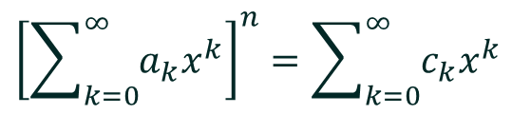


MATHEMATICAL MODEL (contd.)
By using equation 0.314, Ref. 24 we get,
$${\left[\sum_{k=0}^{∞}{a_{k}x^{k}}\right]}^{n}=\sum_{k=0}^{∞}{c_{k}x^{k}}$$
...(1.30)
Where
$c_{0}=a_{0}^{n}$, $c_{m}=\frac{1}{{ma}_{0}}\sum_{k=1}^{m}{\left(kn−m+k\right)a_{k}c_{m−k}}$
...(1.31)
for $m≥1,$and $n$ is a natural number
Using equation (1.29) and (1.30), we get
$$M_{Y}\left(s\right)=\sum_{k=0}^{n_{T}n_{R}}{\left({n_{T}n_{R} \atop k}\right)\left[\sum_{l=0}^{∞}{{\tilde{c}}_{l}\left(m_{1}γ_{1},m_{2}γ_{2}\right)s^{−{lγ}_{1}}}\right]\left[\sum_{l=0}^{∞}{{\tilde{c}}_{l}\left(m_{2}γ_{2},m_{1}γ_{1}\right)s^{−{lγ}_{2}}}\right]}$$
...(1.32)
$$s^{−m_{1}γ_{1}\left(n_{T}n_{R}−k\right)−km_{2}γ_{2}}$$
FSO |
29

Slide 30




MATHEMATICAL MODEL (contd.)
Where,
$${\tilde{c}}_{0}\left(m_{1}γ_{1},m_{2}γ_{2}\right)= {\left[{\tilde{b}}_{0}\left(m_{1}γ_{1},m_{2}γ_{2}\right)\right]}^{n_{T}n_{R}−k}$$
...(1.33)
$${\tilde{c}}_{0}\left(m_{2}γ_{2},m_{1}γ_{1}\right)= {\left[{\tilde{b}}_{0}\left(m_{2}γ_{2},m_{1}γ_{1}\right)\right]}^{k}$$
...(1.34)
$${\tilde{c}}_{m}\left(m_{1}γ_{1},m_{2}γ_{2}\right)= \frac{1}{m{\tilde{b}}_{0}\left(m_{1}γ_{1},m_{2}γ_{2}\right)}\sum_{l=1}^{m}{\left(l\left(n_{T}n_{R}−k\right)−m+l\right)}$$
...(1.35)
$${\tilde{b}}_{0}\left(m_{1}γ_{1},m_{2}γ_{2}\right){\tilde{c}}_{ m−l}\left(m_{1}γ_{1},m_{2}γ_{2}\right)$$
$${\tilde{c}}_{m}\left(m_{2}γ_{2},m_{1}γ_{1}\right)= \frac{1}{m{\tilde{b}}_{0}\left(m_{2}γ_{2},m_{1}γ_{1}\right)}\sum_{l=1}^{m}{\left(lk−m+l\right)}{\tilde{b}}_{0}\left(m_{2}γ_{2},m_{1}γ_{1}\right)$$
...(1.36)
$${\tilde{c}}_{ m−l}\left(m_{2}γ_{2},m_{1}γ_{1}\right)$$
FSO |
30

Slide 31
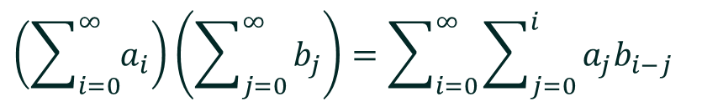
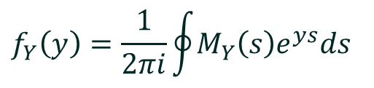

MATHEMATICAL MODEL (contd.)
From the principle of multiplication of infinite series,
$$\left(\sum_{i=0}^{∞}{a_{i}}\right)\left(\sum_{j=0}^{∞}{b_{j}}\right)=\sum_{i=0}^{∞}{\sum_{j=0}^{i}{a_{j}b_{i−j}}}$$
...(1.37)
Equation (1.32) can be rewritten as
$$M_{Y}\left(s\right)=\sum_{k=0}^{n_{T}n_{R}}{\left({n_{T}n_{R} \atop k}\right)\sum_{i=0}^{∞}{\sum_{j=0}^{i}{{\tilde{c}}_{j}\left(m_{1}γ_{1},m_{2}γ_{2}\right){\tilde{c}}_{i−j}\left(m_{2}γ_{2},m_{1}γ_{1}\right)}}}$$
...(1.38)
$$s^{−m_{1}γ_{1}\left(n_{T}n_{R}−k\right)−km_{2}γ_{2}−jγ_{1}−\left(i−j\right)γ_{2}}$$
From the definition of Inverse Laplace
$$f_{Y}\left(y\right)=\frac{1}{2πi}\oint{M_{Y}\left(s\right)e^{ys}ds}$$
...(1.39)
FSO |
31

Slide 32
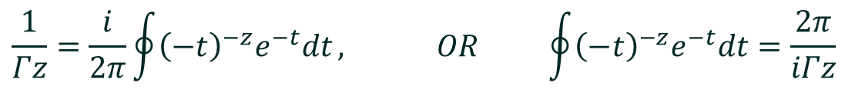
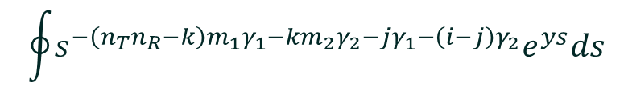
MATHEMATICAL MODEL (contd.)
From equation (8.315) Ref. 24, we get
$$\frac{1}{Γz}=\frac{i}{2π}\oint{{\left(−t\right)}^{−z}e^{−t}dt}, OR \oint{{\left(−t\right)}^{−z}e^{−t}dt}=\frac{2π}{iΓz}$$
...(1.40)
From equations (1.38) and (1.39)
$$f_{Y}\left(y\right)=\frac{1}{2πi}\oint{\sum_{k=0}^{n_{T}n_{R}}{\left({n_{T}n_{R} \atop k}\right)\sum_{i=0}^{∞}{\sum_{j=0}^{i}{{\tilde{c}}_{j}\left(m_{1}γ_{1},m_{2}γ_{2}\right){\tilde{c}}_{i−j}\left(m_{2}γ_{2},m_{1}γ_{1}\right)}}}}$$
...(1.41)
$$s^{−m_{1}γ_{1}\left(n_{T}n_{R}−k\right)−km_{2}γ_{2}−jγ_{1}−\left(i−j\right)γ_{2}}e^{ys}ds$$
$$f_{Y}\left(y\right)=\frac{1}{2πi}\sum_{k=0}^{n_{T}n_{R}}{\left({n_{T}n_{R} \atop k}\right)\sum_{i=0}^{∞}{\sum_{j=0}^{i}{{\tilde{c}}_{j}\left(m_{1}γ_{1},m_{2}γ_{2}\right){\tilde{c}}_{i−j}\left(m_{2}γ_{2},m_{1}γ_{1}\right)}}}$$
...(1.42)
$$\oint{{s^{−\left(n_{T}n_{R}−k\right)m_{1}γ_{1}−km_{2}γ_{2}−jγ_{1}−\left(i−j\right)γ_{2}}e}^{ys}ds}$$
FSO |
32

Slide 33
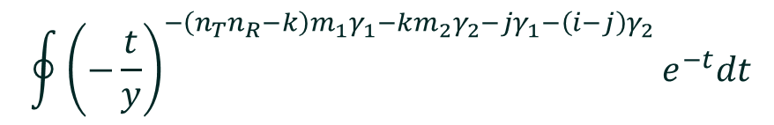
MATHEMATICAL MODEL (contd.)
Substituting, $s=−\frac{t}{y} and ds=−\frac{dt}{y}$ in equation (2.42), we get
$$f_{Y}\left(y\right)=−\frac{1}{2πyi}\sum_{k=0}^{n_{T}n_{R}}{\left({n_{T}n_{R} \atop k}\right)\sum_{i=0}^{∞}{\sum_{j=0}^{i}{{\tilde{c}}_{j}\left(m_{1}γ_{1},m_{2}γ_{2}\right){\tilde{c}}_{i−j}\left(m_{2}γ_{2},m_{1}γ_{1}\right)}}}$$
$$\oint{{{\left(−\frac{t}{y}\right)}^{−\left(n_{T}n_{R}−k\right)m_{1}γ_{1}−km_{2}γ_{2}−jγ_{1}−\left(i−j\right)γ_{2}}e}^{−t}dt}$$
...(1.43)
$$f_{Y}\left(y\right)=−\frac{1}{2πi}\sum_{k=0}^{n_{T}n_{R}}{\left({n_{T}n_{R} \atop k}\right)\sum_{i=0}^{∞}{\sum_{j=0}^{i}{{\tilde{c}}_{j}\left(m_{1}γ_{1},m_{2}γ_{2}\right){\tilde{c}}_{i−j}\left(m_{2}γ_{2},m_{1}γ_{1}\right)}}}$$
...(1.44)
$$y^{\left(n_{T}n_{R}−k\right)m_{1}γ_{1}+km_{2}γ_{2}+jγ_{1}+\left(i−j\right)γ_{2}−1}\oint{{{\left(−t\right)}^{−\left(n_{T}n_{R}−k\right)m_{1}γ_{1}−km_{2}γ_{2}−jγ_{1}−\left(i−j\right)γ_{2}}e}^{−t}dt}$$
By using equation (1.40), equation (1.44) can be rewritten as:
FSO |
33

Slide 34


MATHEMATICAL MODEL (contd.)
$$f_{Y}\left(y\right)=−\frac{1}{2πi}\sum_{k=0}^{n_{T}n_{R}}{\left({n_{T}n_{R} \atop k}\right)\sum_{i=0}^{∞}{\sum_{j=0}^{i}{{\tilde{c}}_{j}\left(m_{1}γ_{1},m_{2}γ_{2}\right){\tilde{c}}_{i−j}\left(m_{2}γ_{2},m_{1}γ_{1}\right)}}}$$
$$y^{\left(n_{T}n_{R}−k\right)m_{1}γ_{1}+km_{2}γ_{2}+jγ_{1}+\left(i−j\right)γ_{2}−1}\frac{2π}{iΓ\left(\left(n_{T}n_{R}−k\right)m_{1}γ_{1}+km_{2}γ_{2}+jγ_{1}+\left(i−j\right)γ_{2}\right)}$$
...(1.45)
$$f_{Y}\left(y\right)=\sum_{k=0}^{n_{T}n_{R}}{\left({n_{T}n_{R} \atop k}\right)\sum_{i=0}^{∞}{\sum_{j=0}^{i}{\frac{{\tilde{c}}_{j}\left(m_{1}γ_{1},m_{2}γ_{2}\right){\tilde{c}}_{i−j}\left(m_{2}γ_{2},m_{1}γ_{1}\right)}{Γ\left(\left(n_{T}n_{R}−k\right)m_{1}γ_{1}+km_{2}γ_{2}+jγ_{1}+\left(i−j\right)γ_{2}\right)}}}}$$
...(1.46)
$$y^{\left(n_{T}n_{R}−k\right)m_{1}γ_{1}+km_{2}γ_{2}+jγ_{1}+\left(i−j\right)γ_{2}−1}$$
$$f_{X}\left(x\right)=\sum_{k=0}^{n_{T}n_{R}}{\left({n_{T}n_{R} \atop k}\right)\sum_{i=0}^{∞}{\sum_{j=0}^{i}{\frac{{\tilde{c}}_{j}\left(m_{1}γ_{1},m_{2}γ_{2}\right){\tilde{c}}_{i−j}\left(m_{2}γ_{2},m_{1}γ_{1}\right)}{Γ\left(\left(n_{T}n_{R}−k\right)m_{1}γ_{1}+km_{2}γ_{2}+jγ_{1}+\left(i−j\right)γ_{2}\right)}}}}$$
...(1.47)
$$x^{\left(n_{T}n_{R}−k\right)m_{1}γ_{1}+km_{2}γ_{2}+jγ_{1}+\left(i−j\right)γ_{2}−1}$$
FSO |
34

Slide 35

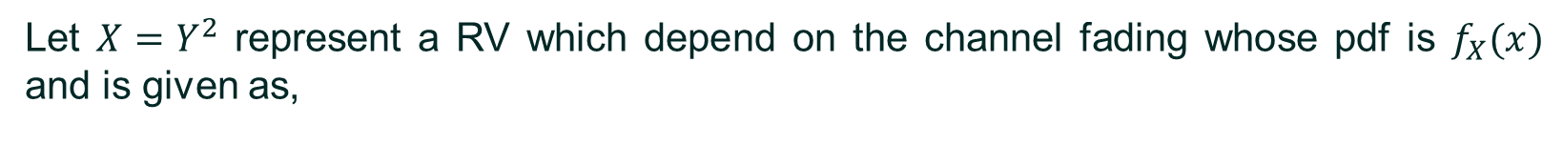
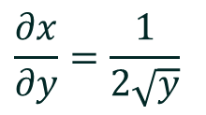
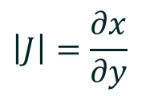

MATHEMATICAL MODEL (contd.)
Let $X=Y^{2}$ represent a RV which depend on the channel fading whose pdf is $f_{X}(x)$ and is given as,
$$Y=\sqrt{X}$$
...(1.48)
$$\left.f_{X}\left(x\right)= \left|J\right|f_{Y}(y\right)$$
...(1.49)
$$\left|J\right|=\frac{∂x}{∂y}$$
...(1.50)
$$\frac{∂x}{∂y}=\frac{1}{2\sqrt{y}}$$
...(1.51)
Substituting the values from equation (1.47) to equation (1.49) we get,
FSO |
35

Slide 36



MATHEMATICAL MODEL (contd.)
$$f_{Y^{2}}\left(y\right)=\frac{1}{2\sqrt{y}}\sum_{k=0}^{n_{T}n_{R}}{\left({n_{T}n_{R} \atop k}\right)\sum_{i=0}^{∞}{\sum_{j=0}^{i}{\frac{{\tilde{c}}_{j}\left(m_{1}γ_{1},m_{2}γ_{2}\right){\tilde{c}}_{i−j}\left(m_{2}γ_{2},m_{1}γ_{1}\right)}{Γ\left(\left(n_{T}n_{R}−k\right)m_{1}γ_{1}+km_{2}γ_{2}+jγ_{1}+\left(i−j\right)γ_{2}\right)}}}}$$
...(1.52)
$$y^{\frac{\left(n_{T}n_{R}−k\right)m_{1}γ_{1}+km_{2}γ_{2}+jγ_{1}+\left(i−j\right)γ_{2}−1}{2}}$$
$$f_{Y^{2}}\left(y\right)=\frac{1}{2\sqrt{y}}\sum_{k=0}^{n_{T}n_{R}}{\left({n_{T}n_{R} \atop k}\right)\sum_{i=0}^{∞}{\sum_{j=0}^{i}{\frac{{\tilde{c}}_{j}\left(m_{1}γ_{1},m_{2}γ_{2}\right){\tilde{c}}_{i−j}\left(m_{2}γ_{2},m_{1}γ_{1}\right)}{Γ\left(\left(n_{T}n_{R}−k\right)m_{1}γ_{1}+km_{2}γ_{2}+jγ_{1}+\left(i−j\right)γ_{2}\right)}}}}$$
...(1.53)
$$y^{\frac{\left(n_{T}n_{R}−k\right)m_{1}γ_{1}+km_{2}γ_{2}+jγ_{1}+\left(i−j\right)γ_{2}}{2}−1}√y$$
$$f_{Y^{2}}\left(y\right)=\sum_{k=0}^{n_{T}n_{R}}{\left({n_{T}n_{R} \atop k}\right)\sum_{i=0}^{∞}{\sum_{j=0}^{i}{\frac{{\tilde{c}}_{j}\left(m_{1}γ_{1},m_{2}γ_{2}\right){\tilde{c}}_{i−j}\left(m_{2}γ_{2},m_{1}γ_{1}\right)}{2Γ\left(\left(n_{T}n_{R}−k\right)m_{1}γ_{1}+km_{2}γ_{2}+jγ_{1}+\left(i−j\right)γ_{2}\right)}}}}$$
...(1.54)
$$y^{\frac{\left(n_{T}n_{R}−k\right)m_{1}γ_{1}+km_{2}γ_{2}+jγ_{1}+\left(i−j\right)γ_{2}}{2}−1}$$
FSO |
36

Slide 37
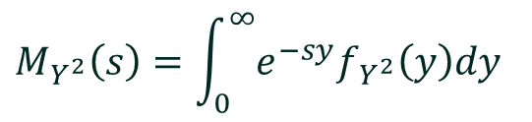

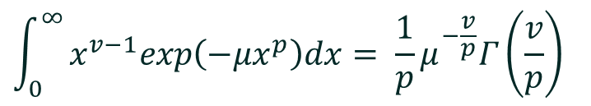

MATHEMATICAL MODEL (contd.)
Now, MFG of $Y^{2}$ is given as,
$$M_{Y^{2}}\left(s\right)=\int_{0}^{∞}{e^{−sy}f_{Y^{2}}\left(y\right)dy}$$
...(1.55)
$$M_{Y^{2}}\left(s\right)=\int_{0}^{∞}{\sum_{k=0}^{n_{T}n_{R}}{\left({n_{T}n_{R} \atop k}\right)\sum_{i=0}^{∞}{\sum_{j=0}^{i}{\frac{{\tilde{c}}_{j}\left(m_{1}γ_{1},m_{2}γ_{2}\right){\tilde{c}}_{i−j}\left(m_{2}γ_{2},m_{1}γ_{1}\right)}{2Γ\left(\left(n_{T}n_{R}−k\right)m_{1}γ_{1}+km_{2}γ_{2}+jγ_{1}+\left(i−j\right)γ_{2}\right)}}}}}$$
...(1.56)
$$y^{\frac{\left(n_{T}n_{R}−k\right)m_{1}γ_{1}+km_{2}γ_{2}+jγ_{1}+\left(i−j\right)γ_{2}}{2}−1}$$
Using equation (3.478(1)), Ref. 24 we get,
$$\int_{0}^{∞}{x^{v−1}exp\left({−μx}^{p}\right)dx= \frac{1}{p}μ^{−\frac{v}{p}}Γ\left(\frac{v}{p}\right)}$$
...(1.57)
FSO |
37

Slide 38
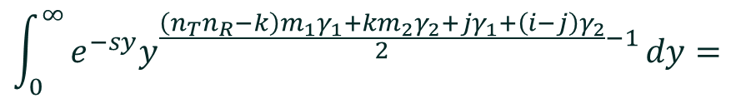
MATHEMATICAL MODEL (contd.)
Comparing equations (1.56) and (1.57) we get,
$$μ=s, x=y, p=1, v=\frac{\left(n_{T}n_{R}−k\right)m_{1}γ_{1}+km_{2}γ_{2}+jγ_{1}+\left(i−j\right)γ_{2}}{2}$$
...(1.58)
We get,
$$\int_{0}^{∞}{e^{−sy}y^{\frac{\left(n_{T}n_{R}−k\right)m_{1}γ_{1}+km_{2}γ_{2}+jγ_{1}+\left(i−j\right)γ_{2}}{2}−1}}dy=$$
...(1.59)
$$Γ\left(\frac{\left(n_{T}n_{R}−k\right)m_{1}γ_{1}+km_{2}γ_{2}+jγ_{1}+\left(i−j\right)γ_{2}}{2}\right)s^{−\frac{\left(n_{T}n_{R}−k\right)m_{1}γ_{1}+km_{2}γ_{2}+jγ_{1}+\left(i−j\right)γ_{2}}{2}}$$
Therefore equation (1.56) becomes,
FSO |
38

Slide 39
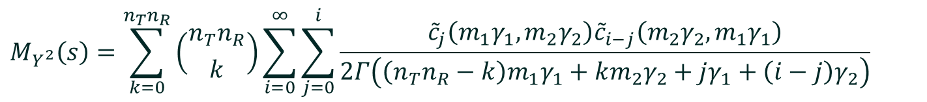
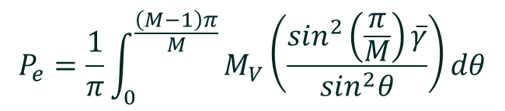
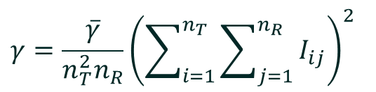
MATHEMATICAL MODEL (contd.)
$$M_{Y^{2}}\left(s\right)=\sum_{k=0}^{n_{T}n_{R}}{\left({n_{T}n_{R} \atop k}\right)\sum_{i=0}^{∞}{\sum_{j=0}^{i}{\frac{{\tilde{c}}_{j}\left(m_{1}γ_{1},m_{2}γ_{2}\right){\tilde{c}}_{i−j}\left(m_{2}γ_{2},m_{1}γ_{1}\right)}{2Γ\left(\left(n_{T}n_{R}−k\right)m_{1}γ_{1}+km_{2}γ_{2}+jγ_{1}+\left(i−j\right)γ_{2}\right)}}}}$$
...(1.60)
$$Γ\left(\frac{\left(n_{T}n_{R}−k\right)m_{1}γ_{1}+km_{2}γ_{2}+jγ_{1}+\left(i−j\right)γ_{2}}{2}\right)s^{−\frac{\left(n_{T}n_{R}−k\right)m_{1}γ_{1}+km_{2}γ_{2}+jγ_{1}+\left(i−j\right)γ_{2}}{2}}$$
Post detection electrical SNR for RC MIMO system (from equation (1.9)) is,
$$γ=\frac{\overline{γ}}{n_{T}^{2}n_{R}}{\left(\sum_{i=1}^{n_{T}}{\sum_{j=1}^{n_{R}}{I_{ij}}}\right)}^{2}$$
...(1.61)
The average SER of subcarrier MPSK (from equation (19), Ref 1) is given as,
$$P_{e}=\frac{1}{π}\int_{0}^{\frac{\left(M−1\right)π}{M}}{M_{V}\left(\frac{\sin^{2}\left(\frac{π}{M}\right)\overline{γ}}{\sin^{2}θ}\right)dθ}$$
...(1.62)
FSO |
39

Slide 40
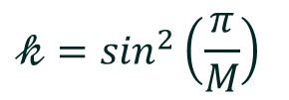
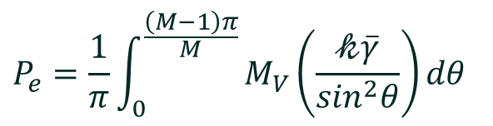
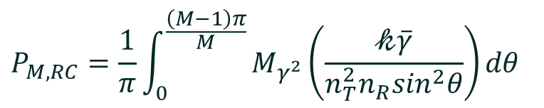
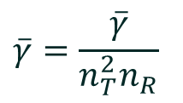
MATHEMATICAL MODEL (contd.)
$$P_{e}=\frac{1}{π}\int_{0}^{\frac{\left(M−1\right)π}{M}}{M_{V}\left(\frac{𝓀\overline{γ}}{\sin^{2}θ}\right)dθ}$$
...(1.63)
Where,
$$𝓀=\sin^{2}\left(\frac{π}{M}\right)$$
...(1.64)
Electrical SNR for RC MIMO system is,
$$\overline{γ}=\frac{\overline{γ}}{n_{T}^{2}n_{R}}$$
...(1.65)
Now, equation (1.63) becomes,
$$P_{M, RC}=\frac{1}{π}\int_{0}^{\frac{\left(M−1\right)π}{M}}{M_{γ^{2}}\left(\frac{𝓀\overline{γ}}{{n_{T}^{2}n_{R}sin}^{2}θ}\right)dθ}$$
...(1.66)
FSO |
40

Slide 41
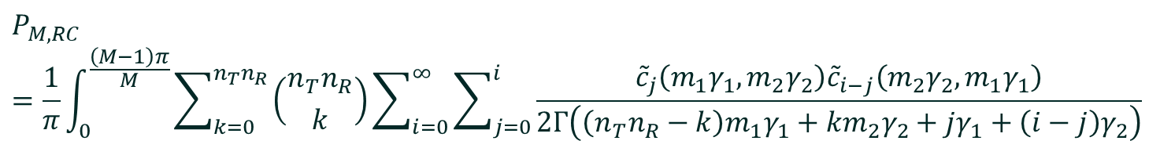
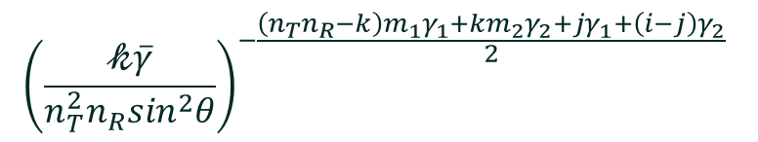
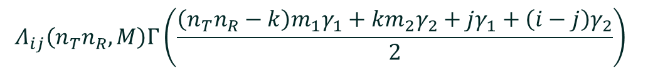
MATHEMATICAL MODEL (contd.)
Substituting equations (1.60), (1.64), (1.65) in equation (1.63) we get
$$P_{M, RC}=\frac{1}{π}\int_{0}^{\frac{\left(M−1\right)π}{M}}{\sum_{k=0}^{n_{T}n_{R}}{\left({n_{T}n_{R} \atop k}\right)\sum_{i=0}^{∞}{\sum_{j=0}^{i}{\frac{{\tilde{c}}_{j}\left(m_{1}γ_{1},m_{2}γ_{2}\right){\tilde{c}}_{i−j}\left(m_{2}γ_{2},m_{1}γ_{1}\right)}{2Γ\left(\left(n_{T}n_{R}−k\right)m_{1}γ_{1}+km_{2}γ_{2}+jγ_{1}+\left(i−j\right)γ_{2}\right)}}}}}$$
$$Γ\left(\frac{\left(n_{T}n_{R}−k\right)m_{1}γ_{1}+km_{2}γ_{2}+jγ_{1}+\left(i−j\right)γ_{2}}{2}\right){\left(\frac{𝓀\overline{γ}}{{n_{T}^{2}n_{R}sin}^{2}θ}\right)}^{−\frac{\left(n_{T}n_{R}−k\right)m_{1}γ_{1}+km_{2}γ_{2}+jγ_{1}+\left(i−j\right)γ_{2}}{2}}dθ$$
...(1.67)
$$P_{M, RC}=\sum_{k=0}^{n_{T}n_{R}}{\left({n_{T}n_{R} \atop k}\right)\sum_{i=0}^{∞}{\sum_{j=0}^{i}{\frac{{\tilde{c}}_{j}\left(m_{1}γ_{1},m_{2}γ_{2}\right){\tilde{c}}_{i−j}\left(m_{2}γ_{2},m_{1}γ_{1}\right)}{2Γ\left(\left(n_{T}n_{R}−k\right)m_{1}γ_{1}+km_{2}γ_{2}+jγ_{1}+\left(i−j\right)γ_{2}\right)}}}}$$
$$Λ_{ij}\left(n_{T}n_{R},M\right)Γ\left(\frac{\left(n_{T}n_{R}−k\right)m_{1}γ_{1}+km_{2}γ_{2}+jγ_{1}+\left(i−j\right)γ_{2}}{2}\right)$$
$${\left(\frac{𝓀\overline{γ}}{{n_{T}^{2}n_{R}sin}^{2}θ}\right)}^{−\frac{\left(n_{T}n_{R}−k\right)m_{1}γ_{1}+km_{2}γ_{2}+jγ_{1}+\left(i−j\right)γ_{2}}{2}}$$
...(1.68)
FSO |
41

Slide 42
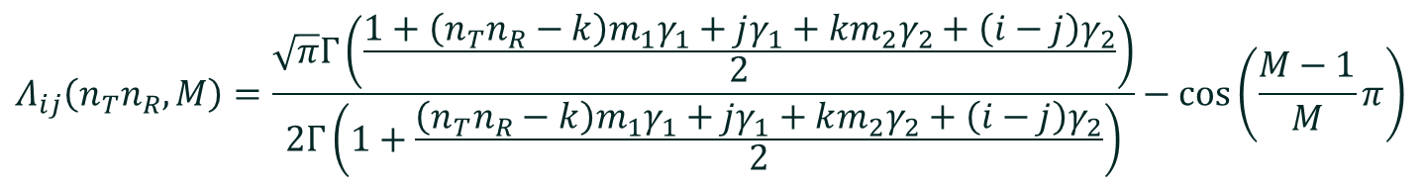
MATHEMATICAL MODEL (contd.)
Where,
$$Λ_{ij}\left(n_{T}n_{R},M\right)=\frac{1}{π}\int_{0}^{\frac{\left(M−1\right)π}{M}}{{\sin{θ}}^{\left(n_{T}n_{R}−k\right)m_{1}γ_{1}+km_{2}γ_{2}+jγ_{1}+\left(i−j\right)γ_{2}}}dθ$$
...(1.69)
On solving equation (1.69) in Mathematica we get,
$$Λ_{ij}\left(n_{T}n_{R},M\right)=\frac{\sqrt{π}Γ\left(\frac{1+\left(n_{T}n_{R}−k\right)m_{1}γ_{1}+jγ_{1}+km_{2}γ_{2}+\left(i−j\right)γ_{2}}{2}\right)}{2Γ\left(1+\frac{\left(n_{T}n_{R}−k\right)m_{1}γ_{1}+jγ_{1}+km_{2}γ_{2}+\left(i−j\right)γ_{2}}{2}\right)}−\cos\left(\frac{M−1}{M}π\right)$$
...(1.70)
$$2F1\left[\frac{1}{2},\frac{1−\left(n_{T}n_{R}−k\right)m_{1}γ_{1}−jγ_{1}−km_{2}γ_{2}−\left(i−j\right)γ_{2}}{2};\frac{3}{2};\cos^{2}\left(\frac{M−1}{M}π\right)\right]$$
Where,
2F1 is a Hypergeometric function.
FSO |
42

Slide 43
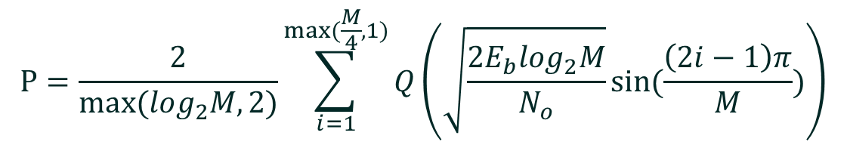

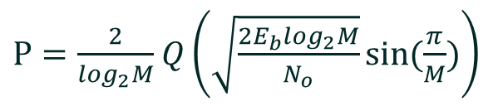
MATHEMATICAL MODEL(contd.)
PROPOSED MODEL
AVERAGE SYMBOL ERROR RATE FOR HYBRID LPPM-MPSK-SIM
The general expression for BER of coherent MPSK is
$$P=\frac{2}{max⁡(log_{2}M,2)}\sum_{i=1}^{max⁡(\frac{M}{4},1)}{Q\left(\sqrt{\frac{2E_{b}log_{2}M}{N_{o}}}sin⁡(\frac{\left(2i−1\right)π}{M})\right)}$$
...(1.71)
For M>4 and $\frac{E_{b}}{N_{o}}≫1 the first term \left(i=1\right) will dominate above equation become$
$P=\frac{2}{log_{2}M}$ $Q\left(\sqrt{\frac{2E_{b}log_{2}M}{N_{o}}}sin⁡(\frac{π}{M})\right)$
...(1.72)
For MPSK the BER expression is
$$P=Q(\sqrt{γ(I)})$$
...(1.73)
FSO |
43

Slide 44





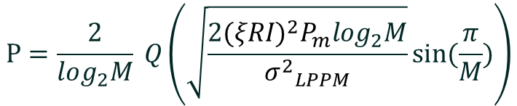
MATHEMATICAL MODEL (contd.)
Where
$γ(I)$=$\frac{2{(ξRI)}^{2}P_{m}}{{σ^{2}}_{LPPM}}$
...(1.74)
Where $ξ$=modulation index , R=responsivity of photodetector
P=Q($\sqrt{\frac{{(ξRI)}^{2}P_{m}}{{σ^{2}}_{LPPM}}}$)
...(1.75)
$$P=\frac{2}{log_{2}M} Q\left(\sqrt{γ(I)log_{2}M}sin⁡(\frac{π}{M})\right)$$
...(1.76)
From equations (1.74) and (1.76) we get
$$P=\frac{2}{log_{2}M} Q\left(\sqrt{\frac{2{(ξRI)}^{2}P_{m}log_{2}M}{{σ^{2}}_{LPPM}}}sin⁡(\frac{π}{M})\right)$$
...(1.77)
Where
${σ^{2}}_{LPPM}$=$\frac{N_{o}R_{b}L}{2M}$
...(1.78)
From equations (1.74) and (1.78) we get
$γ(I)$= $\frac{4{(ξRLP_{m})}^{2}P_{m}log_{2}L}{N_{o}R_{b}L}$
...(1.79)

Slide 45







MATHEMATICAL MODEL (contd.)
We have
$P_{m}$=$\frac{A^{2}}{8}$
...(1.80)
$$I=LP_{m}$$
From equations (1.79) and (1.80) we get
$γ(I)$= $\frac{ξ^{2}R^{2}A^{4}Llog_{2}L}{16}γ$
...(1.81)
Putting R=1,A=1 and $ξ$=1 in equation (1.81) and then putting in equation we get conditional
BER of LPPM-BPSK
$$P_{LPPM−BPSK−SIM}= Q(\frac{1}{4}\sqrt{γLlog_{2}L})$$
...(1.82)
Similarly conditional BER expression of LPPM-MPSK-SIM is
$$P_{LPPM−MPSK−SIM} = \frac{2}{log_{2}M}Q(\frac{1}{4}\sqrt{γLlog_{2}Llog_{2}M}sin⁡(\frac{π}{M}))$$
...(1.83)
The unconditional BER expression of LPPM-BPSK-SIM
...(1.84)
$P_{LPPM−BPSK−SIM}$=$\int_{0}^{∞}{Q\left(\frac{1}{4}\sqrt{γLlog_{2}L}\right)f_{v}\left(v\right)dv}$
$P_{LPPM−BPSK−SIM}\text{=}\int_{0}^{∞}{\int_{0}^{\frac{π}{2}}{\exp\left(\frac{−{\left(\frac{1}{4}\sqrt{γLlog_{2}L}\right)}^{2}}{2sin^{2}θ}\right)dθ}}$ $f_{v}\left(v\right)dv$
...(1.85)

Slide 46







MATHEMATICAL MODEL (contd.)
Putting $γ=\overline{γ}v$ in equation (1.85) we get
$P_{LPPM−BPSK−SIM}\text{=}\int_{0}^{∞}{\int_{0}^{\frac{π}{2}}{\exp\left(\frac{−(\frac{1}{16}\overline{γ}Llog_{2}L)}{2sin^{2}θ}v\right)dθ}}$ $f_{v}\left(v\right)dv$
...(1.86)
$P_{LPPM−BPSK−SIM}\text{=}\int_{0}^{∞}{\int_{0}^{\frac{π}{2}}{\exp\left(−sv\right)dθ}}$ $f_{v}\left(v\right)dv$
...(1.87)
Where
$$s=\frac{(\overline{γ}Llog_{2}L)}{32sin^{2}θ}$$
...(1.88)
We have
$$M_{v}=\int_{0}^{∞}{\exp\left(−sv\right)f_{v}\left(v\right)dv}$$
...(1.89)
From equations (1.87) and (1.89) we get
$P_{LPPM−BPSK−SIM}\text{=}\int_{0}^{\frac{π}{2}}{M_{v}(s)}$d$θ$
...(1.90)
$P_{LPPM−BPSK−SIM}\text{=}\int_{0}^{\frac{π}{2}}{M_{v}(\frac{(\overline{γ}Llog_{2}L)}{32sin^{2}θ})}$d$θ$
...(1.91)
$P_{LPPM−BPSK−SIM}\text{=}\int_{0}^{\frac{π}{2}}{M_{v}(\frac{(\overline{kγ})}{sin^{2}θ})}$d$θ$
...(1.92)
...(1.93)
Where
$$k=\frac{(Llog_{2}L)}{32}$$

Slide 47




MATHEMATICAL MODEL (contd.)
The unconditional BER expression of LPPM-MPSK-SIM
$P_{LPPM−MPSK−SIM}$=$\int_{0}^{∞}{\frac{2}{log_{2}M}Q\left(\frac{1}{4}\sqrt{γLlog_{2}Llog_{2}M}sin⁡(\frac{π}{M})\right)f_{v}\left(v\right)dv}$
...(1.94)
$P_{LPPM−MPSK−SIM}\text{=}\frac{2}{πlog_{2}M}\int_{0}^{∞}{\int_{0}^{\frac{π}{2}}{\exp\left(\frac{−{\left(\frac{1}{4}\sqrt{γLlog_{2}Llog_{2}M}sin⁡(\frac{π}{M})\right)}^{2}}{2sin^{2}θ}\right)dθ}}$ $f_{v}\left(v\right)dv$
...(1.95)
$P_{LPPM−MPSK−SIM}\text{=}\frac{2}{πlog_{2}M}\int_{0}^{∞}{\int_{0}^{\frac{π}{2}}{\exp\left(\frac{−(\frac{1}{16}γLlog_{2}Llog_{2}Msin^{2}⁡(\frac{π}{M})}{2sin^{2}θ}\right)dθ}}$ $f_{v}\left(v\right)dv$
...(1.96)
Putting $γ=\overline{γ}v$ in equation (1.96) we get
...(1.97)
$P_{LPPM−MPSK−SIM}\text{=}\frac{2}{πlog_{2}M}\int_{0}^{∞}{\int_{0}^{\frac{π}{2}}{\exp\left(\frac{−(\frac{1}{16}\overline{γ}Llog_{2}Llog_{2}Msin^{2}⁡(\frac{π}{M})}{2sin^{2}θ}v\right)dθ}}$ $f_{v}\left(v\right)dv$
$P_{LPPM−MPSK−SIM}\text{=}\frac{2}{πlog_{2}M}\int_{0}^{∞}{\int_{0}^{\frac{π}{2}}{\exp\left(−sv\right)dθ}}$ $f_{v}\left(v\right)dv$
...(1.98)
Where
$$s=\frac{(\overline{γ}Llog_{2}Llog_{2}M)}{32sin^{2}θ}⁡\sin^{2}⁡(\frac{π}{M})$$
...(1.99)
We have
$$M_{v}=\int_{0}^{∞}{\exp\left(−sv\right)f_{v}\left(v\right)dv}$$
...(1.100)

Slide 48





MATHEMATICAL MODEL (contd.)
$P_{LPPM−MPSK−SIM}\text{=}\int_{0}^{\frac{π}{2}}{M_{v}(\frac{(\overline{kγ})}{sin^{2}θ})}$d$θ$
...(1.101)
$$k=\frac{(Llog_{2}Llog_{2}M)}{32sin^{2}θ}⁡\sin^{2}⁡(\frac{π}{M})$$
Where
...(1.102)
AVERAGE SYMBOL ERROR RATE FOR HYBRID LPPM-BPSK-SIM FOR SISO SYSTEM
The Average SER expression of LPPM-MPSK-SIM
$P_{LPPM−BPSK−SIM}\text{=}\int_{0}^{\frac{π}{2}}{M_{v}(\frac{(\overline{kγ})}{sin^{2}θ})}$d$θ$
...(1.103)
Where
$$k=\frac{(Llog_{2}L)}{32}$$
...(1.104)
From equation (1.22) we get
$$M_{x}\left(s\right)=\sum_{l=0}^{∞}{b_{l}(m_{1}γ_{1},m_{2}γ_{2})s^{−\frac{lγ_{1}+m_{1}γ_{1}}{2}}}+\sum_{l=0}^{∞}{b_{l}(m_{2}γ_{2},m_{1}γ_{1})s^{−\frac{lγ_{2}+m_{2}γ_{2}}{2}}}$$
...(1.105)

Slide 49





MATHEMATICAL MODEL (contd.)
From equations (1.103) and (1.105) the average SER of LPPM-BPSK-SIM for SISO is
$$P_{LPPM−BPSK−SIM}=\sum_{l=0}^{∞}{\begin{aligned}\{b_{I}(m_{1}γ_{1},m_{2}γ_{2})∧(m_{1}γ_{1}){(k\overline{γ})}^{−\frac{lγ_{1}+m_{1}γ_{1}}{2}} \\ +b_{I}(m_{2}γ_{2},m_{1}γ_{1})∧(m_{2}γ_{2}){\left(k\overline{γ}\right)}^{−\frac{lγ_{2}+m_{2}γ_{2}}{2}}\} \end{aligned}}$$
...(1.106)
Where
$∧\left(m_{1}γ_{1}\right)$=$\int_{0}^{∞}{{(sinθ)}^{lγ_{1}+m_{1}γ_{1}}d}θ$
...(1.107)
$$∧\left(m_{1}γ_{1}\right)=\frac{\sqrt{π}Γ[\frac{1}{2}(1+(l+m_{1})γ_{1})]}{2Γ[ (1+\frac{1}{2}(l+m_{1})γ_{1})]}$$
...(1.108)
$∧\left(m_{1}γ_{1}\right)$=$\int_{0}^{∞}{{(sinθ)}^{lγ_{2}+m_{2}γ_{2}}dθ}$
...(1.109)
$$∧\left(m_{1}γ_{1}\right)=\frac{\sqrt{π}Γ[\frac{1}{2}(1+(l+m_{2})γ_{2})]}{2Γ[ (1+\frac{1}{2}(l+m_{2})γ_{2})]}$$
...(1.110)

Slide 50



MATHEMATICAL MODEL (contd.)
AVERAGE SYMBOL ERROR RATE FOR HYBRID LPPM-MPSK-SIM FOR SISO SYSTEM
The Average SER expression of LPPM-MPSK-SIM
$P_{LPPM−MPSK−SIM}\text{=}\frac{2}{πlog_{2}M}\int_{0}^{\frac{π}{2}}{M_{v}(\frac{(\overline{kγ})}{sin^{2}θ})}$d$θ$
...(1.111)
Where
$$\overline{k}=\frac{(Llog_{2}Llog_{2}M)}{32sin^{2}θ}⁡\sin^{2}⁡(\frac{π}{M})$$
...(1.112)
From equation (1.22) we get
$$M_{x}\left(s\right)=\sum_{l=0}^{∞}{b_{l}(m_{1}γ_{1},m_{2}γ_{2})s^{−\frac{lγ_{1}+m_{1}γ_{1}}{2}}}+\sum_{l=0}^{∞}{b_{l}(m_{2}γ_{2},m_{1}γ_{1})s^{−\frac{lγ_{2}+m_{2}γ_{2}}{2}}}$$
...(1.113)
From equations (1.111) and (1.113) the average SER of LPPM-BPSK-SIM for SISO is

Slide 51





MATHEMATICAL MODEL (contd.)
$$P_{LPPM−MPSK−SIM}=\frac{2}{log_{2}M}\sum_{l=0}^{∞}{\begin{aligned}\{b_{I}(m_{1}γ_{1},m_{2}γ_{2})\overline{Λ}(m_{1}γ_{1}){(\overline{k}\overline{γ})}^{−\frac{lγ_{1}+m_{1}γ_{1}}{2}} \\ +b_{I}(m_{2}γ_{2},m_{1}γ_{1})\overline{Λ}(m_{2}γ_{2}){\left(\overline{k}\overline{γ}\right)}^{−\frac{lγ_{2}+m_{2}γ_{2}}{2}}\} \end{aligned}}$$
...(1.114)
Where
$∧\left(m_{1}γ_{1}\right)$=$\frac{1}{π}\int_{0}^{\frac{π}{2}}{{(sinθ)}^{lγ_{1}+m_{1}γ_{1}}d}θ$
...(1.115)
$$∧\left(m_{1}γ_{1}\right)=\frac{Γ[\frac{1}{2}(1+(l+m_{1})γ_{1})]}{2\sqrt{π}Γ[ (1+\frac{1}{2}(l+m_{1})γ_{1})]}$$
...(1.116)
$∧\left(m_{2}γ_{2}\right)$=$\frac{1}{π}\int_{0}^{\frac{π}{2}}{{(sinθ)}^{lγ_{2}+m_{2}γ_{2}}d}θ$
...(1.117)
$$∧\left(m_{1}γ_{1}\right)=\frac{Γ[\frac{1}{2}(1+(l+m_{2})γ_{2})]}{2\sqrt{π}Γ[ (1+\frac{1}{2}(l+m_{2})γ_{2})]}$$
...(1.118)

Slide 52



MATHEMATICAL MODEL (contd.)
AVERAGE SYMBOL ERROR RATE FOR HYBRID LPPM-BPSK-SIM FOR MIMO SYSTEM
The Average SER expression of LPPM-BPSK-SIM
$P_{LPPM−BPSK−SIM}\text{=}\int_{0}^{\frac{π}{2}}{M_{Y^{2}}(\frac{(k\overline{γ})}{{n^{2}}_{T}n_{R}sin^{2}θ})}$d$θ$
...(1.119)
Where
$$k=\frac{(Llog_{2}L)}{32}$$
...(1.120)
From equations (1.32) we get
$M_{Y^{2}}$(s)=$\sum_{k=0}^{n_{T}n_{R}}{({n_{T}n_{R} \atop k})\sum_{i=0}^{∞}{\sum_{j=0}^{i}{\frac{\overline{cj}\left(m_{1}γ_{1},m_{2}γ_{2}\right){\overline{c}}_{i−j}\left(m_{2}γ_{2},m_{1}γ_{1}\right)}{2Γ\left(\left(n_{T}n_{R}−k\right)m_{1}γ_{1}+km_{2}γ_{2}+jγ_{1}+\left(i−j\right)γ_{2}\right)}Γ\left(\frac{(\left(n_{T}n_{R}−k\right)m_{1}γ_{1}+km_{2}γ_{2}+jγ_{1}+(i−j)γ_{2}}{2}\right)∗}}}$
$${(s)}^{−(\frac{(\left(n_{T}n_{R}−k\right)m_{1}γ_{1}+km_{2}γ_{2}+jγ_{1}+(i−j)γ_{2}}{2}) }$$
...(1.121)
From equations (1.119) and (1.121) the average SER of LPPM-BPSK-SIM for MIMO is

Slide 53



MATHEMATICAL MODEL (contd.)
$P_{LPPM−BPSK−SIM}$= $\int_{0}^{\frac{π}{2}}{\sum_{k=0}^{n_{T}n_{R}}{({n_{T}n_{R} \atop k})\sum_{i=0}^{∞}{\sum_{j=0}^{i}{\frac{\overline{c}\left(m_{1}γ_{1},m_{2}γ_{2}\right){\overline{c}}_{i−j}\left(m_{2}γ_{2},m_{1}γ_{1}\right)}{2Γ\left(\left(n_{T}n_{R}−k\right)m_{1}γ_{1}+km_{2}γ_{2}+jγ_{1}+\left(i−j\right)γ_{2}\right)}Γ\left(\frac{(\left(n_{T}n_{R}−k\right)m_{1}γ_{1}+km_{2}γ_{2}+jγ_{1}+(i−j)γ_{2}}{2}\right)∗}}}}$ ${ (\frac{(k\overline{γ})}{{n^{2}}_{T}n_{R}sin^{2}θ})}^{−(\frac{(\left(n_{T}n_{R}−k\right)m_{1}γ_{1}+km_{2}γ_{2}+jγ_{1}+\left(i−j\right)γ_{2})}{2}) }$d$θ$
...(1.122)
$P_{LPPM−BPSK−SIM}$= $\int_{0}^{\frac{π}{2}}{\sum_{k=0}^{n_{T}n_{R}}{({n_{T}n_{R} \atop k})\sum_{i=0}^{∞}{\sum_{j=0}^{i}{\frac{\overline{c}\left(m_{1}γ_{1},m_{2}γ_{2}\right){\overline{c}}_{i−j}\left(m_{2}γ_{2},m_{1}γ_{1}\right)∧_{ij}(n_{T}n_{R},M)}{2Γ\left(\left(n_{T}n_{R}−k\right)m_{1}γ_{1}+km_{2}γ_{2}+jγ_{1}+\left(i−j\right)γ_{2}\right)}Γ\left(\frac{(\left(n_{T}n_{R}−k\right)m_{1}γ_{1}+km_{2}γ_{2}+jγ_{1}+(i−j)γ_{2}}{2}\right)∗}}}}$ ${ (\frac{(k\overline{γ})}{{n^{2}}_{T}n_{R}})}^{−(\frac{(\left(n_{T}n_{R}−k\right)m_{1}γ_{1}+km_{2}γ_{2}+jγ_{1}+\left(i−j\right)γ_{2})}{2}) }$d$θ$
...(1.123)
Where
$∧_{ij}(n_{T}n_{R},M)$=$\int_{0}^{\frac{π}{2}}{{(sinθ)}^{(\left(n_{T}n_{R}−k\right)m_{1}γ_{1}+km_{2}γ_{2}+jγ_{1}+\left(i−j\right)γ_{2})}dθ}$
...(1.124)
$∧_{ij}(n_{T}n_{R},M)$=$\frac{\sqrt{π}Γ[\frac{1}{2}\left({1−{km}_{1}γ_{1}+{m_{1}n}_{T}n_{R}γ}_{1}+j\left(γ_{1}{−γ}_{2}\right)+iγ_{2}+km_{2}γ_{2}\right)]}{2Γ[\frac{1}{2}\left({2−{km}_{1}γ_{1}+{m_{1}n}_{T}n_{R}γ}_{1}+j\left(γ_{1}{−γ}_{2}\right)+iγ_{2}+km_{2}γ_{2}\right))}$
...(1.125)

Slide 54



MATHEMATICAL MODEL (contd.)
AVERAGE SYMBOL ERROR RATE FOR HYBRID LPPM-BPSK-SIM FOR MIMO SYSTEM
The Average SER expression of LPPM-BPSK-SIM
$P_{LPPM−MPSK−SIM}\text{=}\frac{2}{πlog_{2}M}\int_{0}^{\frac{π}{2}}{M_{v}(\frac{(\overline{kγ})}{sin^{2}θ})}$d$θ$
...(1.126)
$$\overline{k}=\frac{(Llog_{2}Llog_{2}M)}{32sin^{2}θ}⁡\sin^{2}⁡(\frac{π}{M})$$
Where
...(1.127)
From equation (1.32) we get
$M_{Y^{2}}$(s)=$\sum_{k=0}^{n_{T}n_{R}}{({n_{T}n_{R} \atop k})\sum_{i=0}^{∞}{\sum_{j=0}^{i}{\frac{{\overline{c}}_{j}\left(m_{1}γ_{1},m_{2}γ_{2}\right){\overline{c}}_{i−j}\left(m_{2}γ_{2},m_{1}γ_{1}\right)}{2Γ\left(\left(n_{T}n_{R}−k\right)m_{1}γ_{1}+km_{2}γ_{2}+jγ_{1}+\left(i−j\right)γ_{2}\right)}Γ\left(\frac{(\left(n_{T}n_{R}−k\right)m_{1}γ_{1}+km_{2}γ_{2}+jγ_{1}+(i−j)γ_{2}}{2}\right)∗}}}$
...(1.128)
$${(s)}^{−(\frac{(\left(n_{T}n_{R}−k\right)m_{1}γ_{1}+km_{2}γ_{2}+jγ_{1}+(i−j)γ_{2}}{2}) }$$
From equations (1.126) and (1.128) the average SER of LPPM-BPSK-SIM for MIMO is

Slide 55



MATHEMATICAL MODEL (contd.)
$P_{LPPM−MPSK−SIM}$= $\int_{0}^{\frac{π}{2}}{\sum_{k=0}^{n_{T}n_{R}}{({n_{T}n_{R} \atop k})\sum_{i=0}^{∞}{\sum_{j=0}^{i}{\frac{\overline{c}\left(m_{1}γ_{1},m_{2}γ_{2}\right){\overline{c}}_{i−j}\left(m_{2}γ_{2},m_{1}γ_{1}\right)}{2Γ\left(\left(n_{T}n_{R}−k\right)m_{1}γ_{1}+km_{2}γ_{2}+jγ_{1}+\left(i−j\right)γ_{2}\right)}Γ\left(\frac{(\left(n_{T}n_{R}−k\right)m_{1}γ_{1}+km_{2}γ_{2}+jγ_{1}+(i−j)γ_{2}}{2}\right)∗}}}}$ ${ (\frac{(\overline{k}\overline{γ})}{{n^{2}}_{T}n_{R}sin^{2}θ})}^{−(\frac{(\left(n_{T}n_{R}−k\right)m_{1}γ_{1}+km_{2}γ_{2}+jγ_{1}+\left(i−j\right)γ_{2})}{2}) }$d$θ$
...(1.129)
$P_{LPPM−MPSK−SIM}$= $\int_{0}^{\frac{π}{2}}{\sum_{k=0}^{n_{T}n_{R}}{({n_{T}n_{R} \atop k})\sum_{i=0}^{∞}{\sum_{j=0}^{i}{\frac{\overline{c}\left(m_{1}γ_{1},m_{2}γ_{2}\right){\overline{c}}_{i−j}\left(m_{2}γ_{2},m_{1}γ_{1}\right){\overline{Λ}}_{ij}(n_{T}n_{R},M)}{2Γ\left(\left(n_{T}n_{R}−k\right)m_{1}γ_{1}+km_{2}γ_{2}+jγ_{1}+\left(i−j\right)γ_{2}\right)}Γ\left(\frac{(\left(n_{T}n_{R}−k\right)m_{1}γ_{1}+km_{2}γ_{2}+jγ_{1}+(i−j)γ_{2}}{2}\right)∗}}}}$ ${ (\frac{(\overline{k}\overline{γ})}{{n^{2}}_{T}n_{R}})}^{−(\frac{(\left(n_{T}n_{R}−k\right)m_{1}γ_{1}+km_{2}γ_{2}+jγ_{1}+\left(i−j\right)γ_{2})}{2}) }$d$θ$
...(1.130)
Where
$∧_{ij}(n_{T}n_{R},M)$=$\frac{1}{π}\int_{0}^{\frac{π}{2}}{{(sinθ)}^{(\left(n_{T}n_{R}−k\right)m_{1}γ_{1}+km_{2}γ_{2}+jγ_{1}+\left(i−j\right)γ_{2})}dθ}$
...(1.131)
$∧_{ij}(n_{T}n_{R},M)$=$\frac{Γ[\frac{1}{2}\left({1−{km}_{1}γ_{1}+{m_{1}n}_{T}n_{R}γ}_{1}+j\left(γ_{1}{−γ}_{2}\right)+iγ_{2}+km_{2}γ_{2}\right)]}{2\sqrt{π}Γ[\frac{1}{2}\left({2−{km}_{1}γ_{1}+{m_{1}n}_{T}n_{R}γ}_{1}+j\left(γ_{1}{−γ}_{2}\right)+iγ_{2}+km_{2}γ_{2}\right))}$
...(1.132)

Slide 56



RESULT AND ANALYSIS
Parameters Used:
$$m_{1}=4$$
$$m_{2}=4.5$$
$$γ_{1}=2.1$$
$$γ_{2}=2.1$$
$$Ω_{1}=1.0676$$
$$Ω_{2}=1.06$$
Fig 1.2 SER of MPSK SIM for MIMO FSO system with RC over double GG fading under weak turbulence with ${σ^{2}}_{Rytov}=0.1$.
It is observed that for 45 dB average electrical SNR, the corresponding values of average SER are $1.728×{10}^{−59}$, $1.692×{10}^{−53}$, $2.031×{10}^{−43}$, and $2.335×{10}^{−32}$ for BPSK, 4-PSK, 8-PSK, and 16-PSK respectively.
FSO |
56

Slide 57


RESULT AND ANALYSIS(contd.)
Parameters Used:
$$m_{1}=\text{2.65}$$
$$m_{2}=2.65$$
$$γ_{1}\text{= 0.9135}$$
$$γ_{2}=\text{1.4358}$$
$$Ω_{1}=\text{0.9836}$$
$$Ω_{2}=\text{1.1745}\text{.}$$
Fig 1.3 SER of MPSK SIM for MIMO FSO system with RC over double GG fading under moderate turbulence with ${σ^{2}}_{Rytov}$= 2.
It is observed that for 45 dB average electrical SNR, the corresponding values of average SER are 1.535 × 10−10, 1.628 × 10−9, 3.373 × 10−8 , and 9.27 × 10−7 for BPSK, 4-PSK, 8-PSK, and 16- PSK respectively.

Slide 58


RESULT AND ANALYSIS(contd.)
Parameters Used:
$$m_{1}=0.5$$
$$m_{2}=1.8$$
$$γ_{1}=1.8621$$
$$γ_{2}=0.7638$$
$$Ω_{1}=1.5074$$
$$Ω_{2}=0.928$$
Fig 1.4 SER of MPSK SIM for MIMO FSO system with RC over double GG fading under strong turbulence with ${σ^{2}}_{Rytov}$= 25.
It is observed that for 45 dB average electrical SNR, the corresponding values of average SER are 4.067×10−5, 0.0001837 , 0.0009708 and 0.005925 for BPSK, 4-PSK, 8-PSK, and 16-PSK respectively

Slide 59


RESULT AND ANALYSIS(contd.)
Parameters Used:
$$m_{1}=\text{2.65}$$
$$m_{2}=2.65$$
$$γ_{1}\text{= 0.9135}$$
$$γ_{2}=\text{1.4358}$$
$$Ω_{1}=\text{0.9836}$$
$$Ω_{2}=\text{1.1745}\text{.}$$
Fig 1.5 SER of BPSK SIM for MIMO FSO system with RC for three different laser-photodetector combinations under moderate turbulence with ${σ^{2}}_{Rytov}$=2.
It is observed that for 45 dB average electrical SNR, the corresponding values of average SER are 8.351 ×10−10, 1.535 ×10−10, and 2.823 ×10−11 for 𝑛𝑇=4, 𝑛𝑅=1, 𝑛𝑇=2, 𝑛𝑅=2, and 𝑛𝑇=1, 𝑛𝑅=4 respectively.

Slide 60

RESULT AND ANALYSIS(contd.)
Parameters Used:
$$m_{1}=\text{2.65}$$
$$m_{2}=2.65$$
$$γ_{1}\text{= 0.9135}$$
$$γ_{2}=\text{1.4358}$$
$$Ω_{1}=\text{0.9836}$$
$$Ω_{2}=\text{1.1745}\text{.}$$
Fig 1.6 SER of 4-PSK SIM for MIMO FSO system with RC for three different laser-photodetector
combinations under moderate turbulence with ${σ^{2}}_{Rytov}$= 2.
It is observed that for 45 dB average electrical SNR, the corresponding values of average SER are 8.871 × 10−9, 1.628 × 10−9, and 2.991 × 10−10 for 𝑛𝑇 = 4, 𝑛𝑅 = 1, 𝑛𝑇 = 2, 𝑛𝑅 = 2, and 𝑛𝑇 = 1, 𝑛𝑅 = 4 respectively.

Slide 61

RESULT AND ANALYSIS(contd.)
Parameters Used:
$$m_{1}=\text{2.65}$$
$$m_{2}=2.65$$
$$γ_{1}\text{= 0.9135}$$
$$γ_{2}=\text{1.4358}$$
$$Ω_{1}=\text{0.9836}$$
$$Ω_{2}=\text{1.1745}\text{.}$$
Fig 1.7 SER of 8-PSK SIM for MIMO FSO system with RC for three different laser-photodetector combinations under
moderate turbulence with ${σ^{2}}_{Rytov}$= 2
It is observed that for 45 dB average electrical SNR, the corresponding values of average SER are 1.848×10−7, 3.373×10−8, and 6.179×10−9 for 𝑛𝑇=4, 𝑛𝑅=1, 𝑛𝑇=2, 𝑛𝑅=2, and 𝑛𝑇=1, 𝑛𝑅=4 respectively.

Slide 62

RESULT AND ANALYSIS(contd.)
Parameters Used:
$$m_{1}=\text{2.65}$$
$$m_{2}=2.65$$
$$γ_{1}\text{= 0.9135}$$
$$γ_{2}=\text{1.4358}$$
$$Ω_{1}=\text{0.9836}$$
$$Ω_{2}=\text{1.1745}\text{.}$$
Fig 1.8 SER of 16-PSK SIM for MIMO FSO system with RC for three different laser-photodetector combinations under moderate turbulence with ${σ^{2}}_{Rytov}$=2.
It is observed that for 45 dB average electrical SNR, the corresponding values of average SER are 5.173×10−6, 9.27×10−7, and 1.681×10−7 for 𝑛𝑇=4, 𝑛𝑅=1, 𝑛𝑇=2, 𝑛𝑅=2, and 𝑛𝑇=1, 𝑛𝑅=4 respectively.

Slide 63

RESULT AND ANALYSIS(contd.)
Parameters Used:
$$m_{1}=\text{2.65}$$
$$m_{2}=2.65$$
$$γ_{1}\text{= 0.9135}$$
$$γ_{2}=\text{1.4358}$$
$$Ω_{1}=\text{0.9836}$$
$$Ω_{2}=\text{1.1745}\text{.}$$
Fig 1.9 SER of 4PPM MPSK SIM for SISO FSO system over double GG fading under moderate turbulence with ${σ^{2}}_{Rytov}$=2.
It is observed that for the average electrical SNR of 45 dB, the corresponding values of average SER are 0.002003, 0.002186, and 0.003073 for 4PPM 4PSK SIM, 4PPM 8PSK SIM, and 4PPM 16PSK SIM respectively

Slide 64

RESULT AND ANALYSIS(contd.)
Parameters Used:
$$m_{1}=\text{2.65}$$
$$m_{2}=2.65$$
$$γ_{1}\text{= 0.9135}$$
$$γ_{2}=\text{1.4358}$$
$$Ω_{1}=\text{0.9836}$$
$$Ω_{2}=\text{1.1745}\text{.}$$
Fig 1.10 SER of 8PPM MPSK SIM for SISO FSO system over double GG fading under moderate turbulence with ${σ^{2}}_{Rytov}$= 2.
It is observed that for the average electrical SNR of 45 dB, the corresponding values of average SER are 0.001032, 0.001131, and 0.001602 for 8PPM 4PSK SIM, 8PPM 8PSK SIM, and 8PPM 16PSK SIM respectively.

Slide 65

RESULT AND ANALYSIS(contd.)
Parameters Used:
$$m_{1}=\text{2.65}$$
$$m_{2}=2.65$$
$$γ_{1}\text{= 0.9135}$$
$$γ_{2}=\text{1.4358}$$
$$Ω_{1}=\text{0.9836}$$
$$Ω_{2}=\text{1.1745}\text{.}$$
Fig 1.11 SER of 16PPM MPSK SIM for SISO FSO system over double GG fading under moderate turbulence with ${σ^{2}}_{Rytov}$= 2.
It is observed that for the average electrical SNR of 45 dB, the corresponding values of average SER are 0.0005696, 0.0006253, and 0.0008895 for 16PPM 4PSK SIM, 16PPM 8PSK SIM, and 16PPM 16PSK SIM respectively.

Slide 66

RESULT AND ANALYSIS(contd.)
Parameters Used:
$$m_{1}=\text{2.65}$$
$$m_{2}=2.65$$
$$γ_{1}\text{= 0.9135}$$
$$γ_{2}=\text{1.4358}$$
$$Ω_{1}=\text{0.9836}$$
$$Ω_{2}=\text{1.1745}\text{.}$$
Fig 1.12 SER of LPPM 4PSK SIM for SISO FSO system over double GG fading under moderate turbulence with ${σ^{2}}_{Rytov}$=2.
It is observed that for the average electrical SNR of 45 dB, the corresponding values of average SER are 0.002003, 0.001032, and 0.0005696 for 4PPM 4PSK SIM, 8PPM 4PSK SIM, and 16PPM 4PSK SIM respectively.

Slide 67

RESULT AND ANALYSIS(contd.)
Parameters Used:
$$m_{1}=\text{2.65}$$
$$m_{2}=2.65$$
$$γ_{1}\text{= 0.9135}$$
$$γ_{2}=\text{1.4358}$$
$$Ω_{1}=\text{0.9836}$$
$$Ω_{2}=\text{1.1745}\text{.}$$
Fig 1.13 SER of LPPM 8PSK SIM for SISO FSO system over double GG fading under moderate turbulence with ${σ^{2}}_{Rytov}$= 2.
It is observed that for the average electrical SNR of 45 dB, the corresponding values of average SER are 0.002186, 0.001131, and 0.0006253 for 4PPM 8PSK SIM, 8PPM 8PSK SIM, and 16PPM 8SPK SIM respectively.

Slide 68

RESULT AND ANALYSIS(contd.)
Parameters Used:
$$m_{1}=\text{2.65}$$
$$m_{2}=2.65$$
$$γ_{1}\text{= 0.9135}$$
$$γ_{2}=\text{1.4358}$$
$$Ω_{1}=\text{0.9836}$$
$$Ω_{2}=\text{1.1745}\text{.}$$
Fig 1.14 SER of LPPM 16PSK SIM for SISO FSO system over double GG fading under moderate turbulence with ${σ^{2}}_{Rytov}$= 2.
It is observed that for the average electrical SNR of 45 dB, the corresponding values of average SER are 0.003073, 0.001602, and 0.0008895 for 4PPM 16PSK SIM, 8PPM 16PSK SIM, and 16PPM 16PSK SIM respectively.

Slide 69

RESULT AND ANALYSIS(contd.)
Parameters Used:
$$m_{1}=\text{2.65}$$
$$m_{2}=2.65$$
$$γ_{1}\text{= 0.9135}$$
$$γ_{2}=\text{1.4358}$$
$$Ω_{1}=\text{0.9836}$$
$$Ω_{2}=\text{1.1745}\text{.}$$
Fig 1.15 SER of 4PPM MPSK SIM for MIMO FSO system over double GG fading under moderate turbulence with ${σ^{2}}_{Rytov}$=2.
It is observed that for the average electrical SNR of 45 dB, the corresponding values of average SER are 5.736×10−9, 3.337×10−8, and 4.592×10−7 for 4PPM 4PSK SIM, 4PPM 8PSK SIM, and 4PPM 16PSK SIM respectively.

Slide 70

RESULT AND ANALYSIS(contd.)
Parameters Used:
$$m_{1}=\text{2.65}$$
$$m_{2}=2.65$$
$$γ_{1}\text{= 0.9135}$$
$$γ_{2}=\text{1.4358}$$
$$Ω_{1}=\text{0.9836}$$
$$Ω_{2}=\text{1.1745}\text{.}$$
Fig 1.16 SER of 8PPM MPSK SIM for MIMO FSO system over double GG fading under moderate turbulence with ${σ^{2}}_{Rytov}$= 2
It is observed that for the average electrical SNR of 45 dB, the corresponding values of average SER are 3.472 × 10−10, 1.874 × 10−9, and 2.256 × 10−8 for 8PPM 4PSK SIM, 8PPM 8PSK SIM, and 8PPM 16PSK SIM respectively.

Slide 71

RESULT AND ANALYSIS(contd.)
Parameters Used:
$$m_{1}=\text{2.65}$$
$$m_{2}=2.65$$
$$γ_{1}\text{= 0.9135}$$
$$γ_{2}=\text{1.4358}$$
$$Ω_{1}=\text{0.9836}$$
$$Ω_{2}=\text{1.1745}\text{.}$$
Fig 1.17 SER of 16PPM MPSK SIM for MIMO FSO system over double GG fading under moderate turbulence with ${σ^{2}}_{Rytov}$= 2.
It is observed that for the average electrical SNR of 45 dB, the corresponding values of average SER are 2.995×10−11, 1.554×10−10, and 1.723×10−9 for 16PPM 4PSK SIM, 16PPM 8PSK SIM, and 16PPM 16PSK SIM respectively.

Slide 72

RESULT AND ANALYSIS(contd.)
Parameters Used:
$$m_{1}=\text{2.65}$$
$$m_{2}=2.65$$
$$γ_{1}\text{= 0.9135}$$
$$γ_{2}=\text{1.4358}$$
$$Ω_{1}=\text{0.9836}$$
$$Ω_{2}=\text{1.1745}\text{.}$$
Fig 1.18 SER of LPPM 4PSK SIM for MIMO FSO system over double GG fading under moderate turbulence with ${σ^{2}}_{Rytov}$=2.
It is observed that for the average electrical SNR of 45 dB, the corresponding values of average SER are 5.736×10−9, 3.472×10−10, and 2.995×10−11 for 4PPM 4PSK SIM, 8PPM 4PSK SIM, and 16PPM 4PSK SIM respectively.

Slide 73

RESULT AND ANALYSIS(contd.)
Parameters Used:
$$m_{1}=\text{2.65}$$
$$m_{2}=2.65$$
$$γ_{1}\text{= 0.9135}$$
$$γ_{2}=\text{1.4358}$$
$$Ω_{1}=\text{0.9836}$$
$$Ω_{2}=\text{1.1745}\text{.}$$
Fig 1.19 SER of LPPM 8PSK SIM for MIMO FSO system over double GG fading under moderate turbulence with ${σ^{2}}_{Rytov}$= 2.
It is observed that for the average electrical SNR of 45 dB, the corresponding values of average SER are 5.736×10−9, 3.472×10−10, and 2.995×10−11 for 4PPM 4PSK SIM, 8PPM 4PSK SIM, and 16PPM 4PSK SIM respectively.

Slide 74

RESULT AND ANALYSIS(contd.)
Parameters Used:
$$m_{1}=\text{2.65}$$
$$m_{2}=2.65$$
$$γ_{1}\text{= 0.9135}$$
$$γ_{2}=\text{1.4358}$$
$$Ω_{1}=\text{0.9836}$$
$$Ω_{2}=\text{1.1745}\text{.}$$
Fig 1.20 SER of LPPM 16PSK SIM for MIMO FSO system over double GG fading under moderate turbulence with ${σ^{2}}_{Rytov}$= 2.
It is observed that for the average electrical SNR of 45 dB, the corresponding values of average SER are 4.592×10−7, 2.256×10−8, and 1.723×10−9 for 4PPM 16PSK SIM, 8PPM 16PSK SIM, and 16PPM 16PSK SIM respectively.

Slide 75

RESULT AND ANALYSIS(contd.)
Parameters Used:
$$m_{1}=\text{2.65}$$
$$m_{2}=2.65$$
$$γ_{1}\text{= 0.9135}$$
$$γ_{2}=\text{1.4358}$$
$$Ω_{1}=\text{0.9836}$$
$$Ω_{2}=\text{1.1745}\text{.}$$
Fig 1.21 SER of BPSK, 4PSK, 16PPM BPSK SIM, and 16PPM 4PSK SIM for MIMO FSO system over double GG fading under moderate turbulence with ${σ^{2}}_{Rytov}$=2.
It is observed that for the average electrical SNR of 45 dB, the corresponding values of average SER are 1.535×10−10, 1.628×10−9, 4.434×10−12, and 2.831×10−11 for BPSK, 4PSK, and 16PPM BPSK SIM, 16PPM 4PSK SIM respectively

Slide 76

RESULT AND ANALYSIS(contd.)
Parameters Used:
$$m_{1}=\text{2.65}$$
$$m_{2}=2.65$$
$$γ_{1}\text{= 0.9135}$$
$$γ_{2}=\text{1.4358}$$
$$Ω_{1}=\text{0.9836}$$
$$Ω_{2}=\text{1.1745}\text{.}$$
Fig 1.22 SER of 16PPM 4PSK SIM, 16PPM 8PSK SIM for both SISO and MIMO FSO system over double GG fading under moderate turbulence with ${σ^{2}}_{Rytov}$=2.
It is observed that for the average electrical SNR of 45 dB, the corresponding values of average SER are 0.0005696, 2.995×10−11, 0.0006253, and 1.554×10−10 for 16PPM 4PSK SIM SISO, 16PPM 4PSK SIM MIMO, 16PPM 8PSK SIM SISO, and 16PPM 8PSK SIM MIMO respectively.

Slide 77
CONCLUSION
We have modelled the FSO channel using Double Generalized Gamma (GG) distribution under moderate turbulence condition.
We have proposed a new hybrid SIM with LPPM and MPSK and analyzed the SER.
We analyzed the average SER performance of MPSK and hybrid LPPM-MPSK-SIM over double generalized gamma fading under moderate turbulence condition, mathematically as well as using the MATLAB.
New hybrid Modulation can be further used with spatial diversity techniques to improve the FSO system performance.
It can also be applied to other channel models under all ranges of turbulence conditions.

Slide 78
PUBLICATION

Slide 79
REFERENCES
Yi, X., Yao, M. and Wang, X., 2017. MIMO FSO communication using subcarrier intensity modulation over double generalized gamma fading. Optics Communications, 382, pp.64-72.
Kashani, M.A., Uysal, M. and Kavehrad, M., 2015. A novel statistical channel model for turbulence-induced fading in free-space optical systems. Journal of Lightwave Technology, 33(11), pp.2303-2312.
Liu, H., Liao, R., Wei, Z., Hou, Z. and Qiao, Y., 2015. BER analysis of a hybrid modulation scheme based on PPM and MSK subcarrier intensity modulation. IEEE Photonics Journal, 7(4), pp.1-10.
Giri, R.K. and Patnaik, B., 2019. Bit error rate performance analysis of hybrid subcarrier intensity modulation-based FSO with spatial diversity in various weather conditions. Journal of Optical Communications, 40(3), pp.307-314.
FSO |
79

Slide 80
REFERENCES (contd.)
AlQuwaiee, H., Ansari, I.S. and Alouini, M.S., 2016. On the maximum and minimum of double generalized gamma variates with applications to the performance of free-space optical communication systems. IEEE Transactions on Vehicular Technology, 65(11), pp.8822-8831.
Kashani, M.A., Uysal, M. and Kavehrad, M., 2015, June. On the performance of MIMO FSO communications over double generalized gamma fading channels. In 2015 IEEE International Conference on Communications (ICC) (pp. 5144-5149). IEEE.
Aminikashani, M., Kavehrad, M. and Gu, W., 2016, February. Error performance analysis of FSO links with equal gain diversity receivers over double generalized gamma fading channels. In Broadband Access Communication Technologies X (Vol. 9772, p. 97720R). International Society for Optics and Photonics.
FSO |
80

Slide 81
REFERENCES (contd.)
Jagadeesh, V.K., Palliyembil, V., Muthuchidambaranathan, P. and Bui, F.M., 2015. Free space optical communication using subcarrier intensity modulation through generalized turbulence channel with pointing error. Microwave and Optical Technology Letters, 57(8), pp.1958-1961.
Bhatnagar, M.R. and Ghassemlooy, Z., 2016. Performance analysis of gamma–gamma fading FSO MIMO links with pointing errors. Journal of Lightwave technology, 34(9), pp.2158-2169.
Li, J., Liu, J.Q. and Taylor, D.P., 2007. Optical communication using subcarrier PSK intensity modulation through atmospheric turbulence channels.
Kaur, P., Jain, V.K. and Kar, S., 2015. Performance analysis of free space optical links using multi-input multi-output and aperture averaging in presence of turbulence and various weather conditions. IET Communications, 9(8), pp.1104-1109.
FSO |
81

Slide 82
REFERENCES (contd.)
Saeed, R.A. and Abbas, E.B., 2018, August. Performance Evaluation of MIMO FSO Communication with Gamma-Gamma Turbulence Channel using Diversity Techniques. In 2018 International Conference on Computer, Control, Electrical, and Electronics Engineering (ICCCEEE) (pp. 1-5). IEEE.
Johnsi, A.A. and Saminadan, V., 2013, April. Performance of diversity combining techniques for fso-mimo system. In 2013 International Conference on Communication and Signal Processing (pp. 479-483). IEEE.
Saber, M.J. and Keshavarz, A., 2018, May. On performance of adaptive subcarrier intensity modulation over generalized FSO links. In Electrical Engineering (ICEE), Iranian Conference on (pp. 358-361). IEEE.
Sadiku, M.N., Musa, S.M. and Nelatury, S.R., 2016. Free space optical communications: An overview. European scientific journal, 12(9).
FSO |
82

Slide 83
REFERENCES (contd.)
Vellakudiyan, J., Muthuchidambaranathan, P., Bui, F.M. and Palliyembil, V., 2015. Performance of a subcarrier intensity modulated differential phase-shift keying over generalized turbulence channel. AEU-International Journal of Electronics and Communications, 69(11), pp.1569-1573.
Dabiri, M.T., Sadough, S.M.S. and Khalighi, M.A., 2017. FSO channel estimation for OOK modulation with APD receiver over atmospheric turbulence and pointing errors. Optics Communications, 402, pp.577-584.
Kaur, G., Singh, H. and Sappal, A.S., 2017. Free space optical using different modulation techniques—a review. International Journal of Engineering Trends and Technology (IJETT), 43(2).
Popoola, W.O. and Ghassemlooy, Z., 2009. BPSK subcarrier intensity modulated free-space optical communications in atmospheric turbulence. Journal of Lightwave technology, 27(8), pp.967-973.
FSO |
83

Slide 84
REFERENCES (contd.)
Prabu, K. and Kumar, D.S., 2015. BER analysis for BPSK based SIM–FSO communication system over strong atmospheric turbulence with spatial diversity and pointing errors. Wireless Personal Communications, 81(3), pp.1143-1157.
Chatzidiamantis, N.D., Karagiannidis, G.K., Kriezis, E.E. and Matthaiou, M., 2011, June. Diversity combining in hybrid RF/FSO systems with PSK modulation. In 2011 IEEE International Conference on Communications (ICC) (pp. 1-6). IEEE.
Sasiela, R.J., 2007, May. Electromagnetic wave propagation in turbulence: evaluation and application of Mellin transforms. SPIE.
Kilbas, A.A., 2004. H-transforms: Theory and Applications. CRC Press.
Gradshteyn, I.S. and Ryzhik, I.M., 2014. Table of integrals, series, and products. Academic press.
FSO |
84

Slide 85
REFERENCES (contd.)
Ting Jiang and Lin Zhao ,2019. Performance Improvement for Mixed RF–FSO Communication System by Adopting Hybrid Subcarrier Intensity Modulation. Article in MDPI Appl. Sci. 2019, pp 9, 3724-3724.
Marvin K. Simon and Mohamed-Slim Alouini , Digital Communication over Fading Channels
Faridzadeh, M., Gholami, A., Ghassemlooy, Z. and Gatri, A., 2014, September. BPSK-SIM-PPM modulation for free space optical communications. In 7'th International Symposium on Telecommunications (IST'2014) (pp. 794-798). IEEE.
Faridzadeh, M., Gholami, A., Ghassemlooy, Z. and Rajbhandari, S., 2012, July. Hybrid 2-PPM-BPSK-SIM with the spatial diversity for free space optical communications. In 2012 8th International Symposium on Communication Systems, Networks & Digital Signal Processing (CSNDSP) (pp. 1-5). IEEE.
FSO |
85

Slide 86
REFERENCES (contd.)
Tiwari, Pawan, Nikhil Kumar, Pragati Singh, Chhavi Srivastava, M. Lakshmanan, Piyush Jain, and Saurabh Katiyar. "Modeling and Analysis of Hybrid SIM with LPPM and MSK over Double Generalized Gamma Distribution in Free Space Optical Communication System." In 2019 International Conference on Vision Towards Emerging Trends in Communication and Networking (ViTECoN), pp. 1-4. IEEE, 2019.
Lu, J., Letaief, K.B., Chuang, J.I. and Liou, M.L., 1999. M-PSK and M-QAM BER computation using signal-space concepts. IEEE Transactions on communications, 47(2), pp.181-184.
Ghassemlooy, Z. and Popoola, W.O., 2010. Terrestrial free-space optical communications. Mobile and Wireless Communications Network layer and circuit level design, pp.355-392.

Slide 87
THANK YOU!
FOR YOUR ATTENTION
FSO |
87

